Slide 1
The Mocking Islands
Presentation for GEAR+ May 2017 by
Margareta Cronholm
(Most photos by Tomas Cronholm.
Some downloaded from Wikipedia or from sources written)

Slide 2
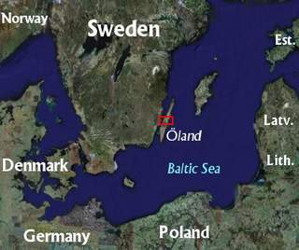
70 years ago, when I was very young my parents took me to what they considered the best place in the world – the Swedish island Öland. They gave me a special feeling for islands

Slide 3
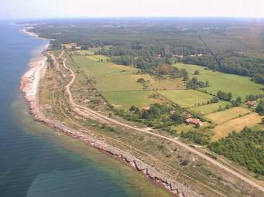
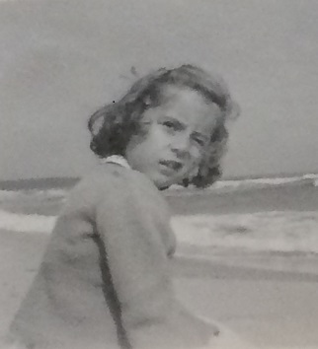
Since June 1947 I have been visiting this place on the northern head of the island at least once a year.
And of course I visited the sister island Gotland many times

Slide 4
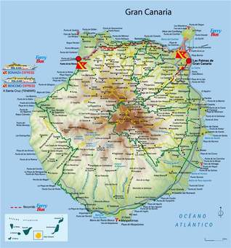
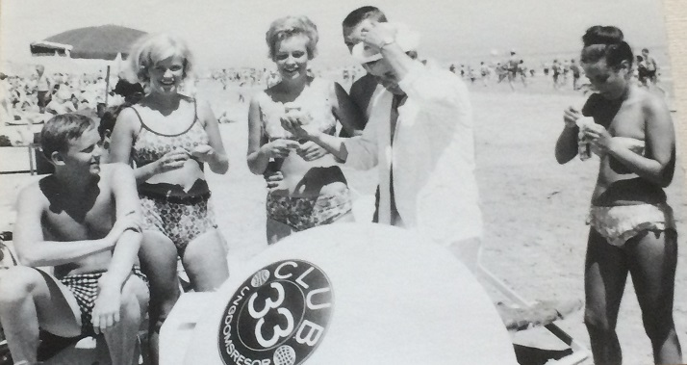
In the mid 60s, like many young persons at that time, I went to Gran Canaria and from then on I am hooked on islands.

Slide 5
There were many islands during my younger age.
Excellent places to spend a week or two during summer;
Mallorca, Crete, Tenerife and many more just for fun
GEAR offered me Ireland (no, not an island perhaps … )
EBU statistics group offered me Cyprus, Mykonos and Delos
most for work but a lot of fun as well

Slide 6
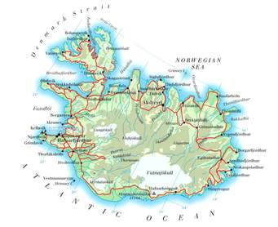
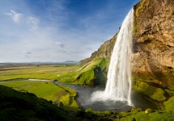
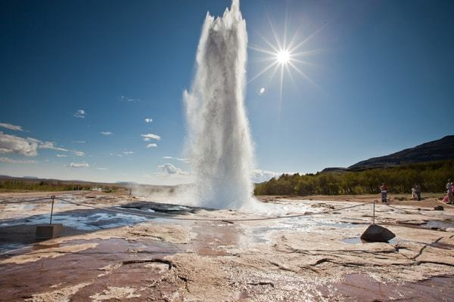
In 1991 I had my first opportunity to visit Iceland
.icwwwelandtours.is/en/vacation-packages/e

Slide 7
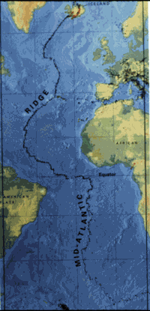
After Iceland I had the idea that I might follow the Mid-Atlantic Ridge south at least as far as the Azores – why not even to Tristan da Cunha – but time flies and I realise there are other islands in the neighbourhood and I visited several of them over the years

Slide 8
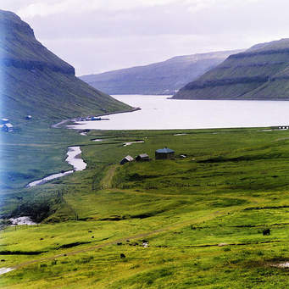
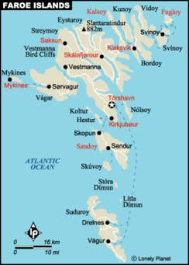
But first me and Tomas had to go to the Faroe Islands!
This came true in 1993. A great experience!
www.fotosidan.se

Slide 9
In 1994 I visited Iceland again and also tried to visit the young
volcanic island Hemey and also fly over Surtsey
shaped in 1963, but the whether was too hard to get there

Slide 10
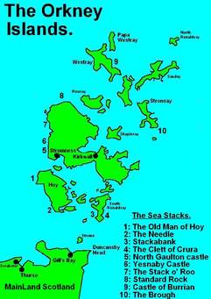
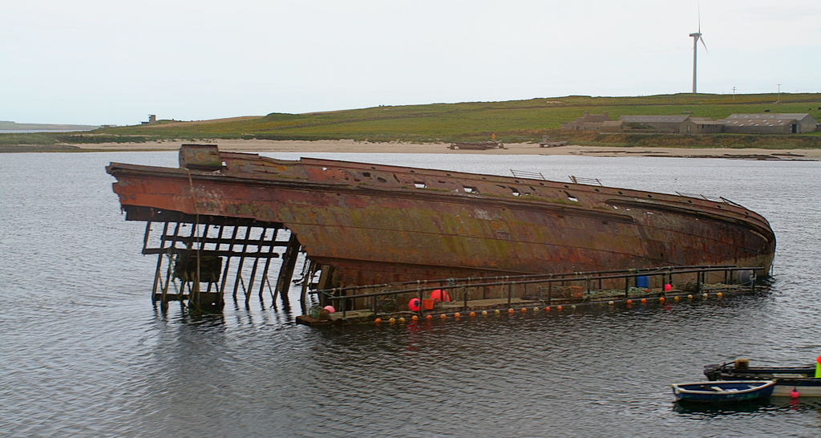
In 1998 The Orkney Islands were in turn for a visit
Photo: John Haslam - Flickr: Block Ship, Scapa Flow
Scapa Flow where 51 German 52 ships,
the vast bulk of the High Seas Fleet, were sunk
after WWI and new brattish block ships were sunk
to block the entrance during WWII – ”Churchill Barriers” – still to be seen

Slide 11
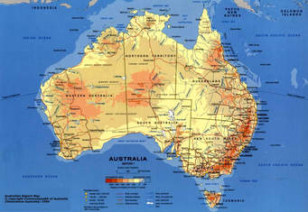
The natural choice next time was of course the Shetland Islands but an other big island came in between. My husband Tomas had two missions there – to study PBL for medical students at University of Newcastle and to visit at the 57th World Science Fiction Convention (no, not an island perhaps … )

Slide 12

The Shetland Islands were absolutely the goal in 2000 but life was complicated with old parents at the time so it was not until 2003 we started up the project again. But it was too complicated to reach the islands. In those days it was Smyril Line that was the way for us Nordic people to get there. A boat once a week from Bergen in Norway.

Slide 13
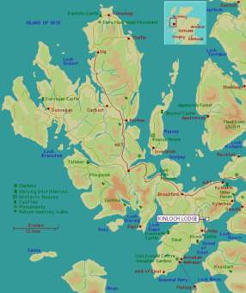
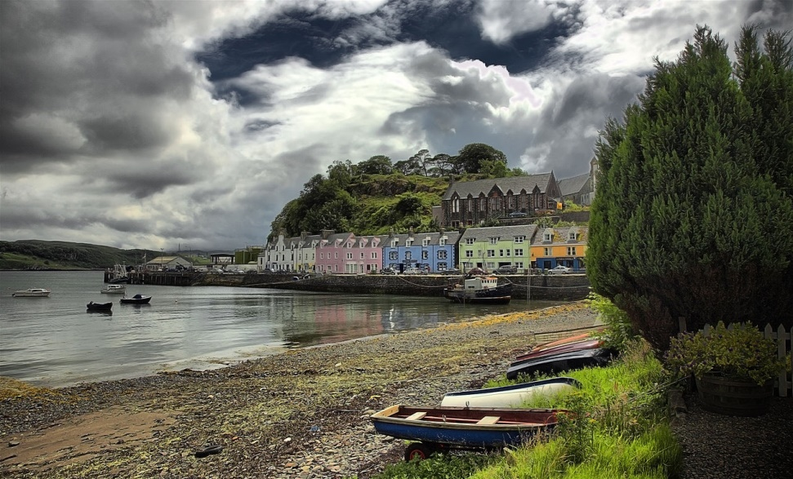
The choice fell on Skye instead in 2003
Photo: Gemot Keller, www.gernot-keller.com

Slide 14
The Shetland islands kept mocking us year after year. We happened to start from the other end of the Mid-Atlantic Ridge when we went to Madeira instead (2004) followed by revisiting Gran Canaria (2007).
The Shetland project had to be kept in a “moth proof” place for a while. Not until 2013 I picked the idea out from its hidden, almost forgotten, place. The idea was to go there in winter time to celebrate Up Helly Aa in January.

Slide 15
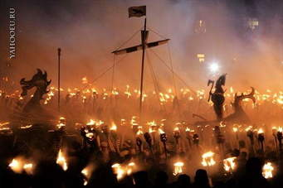

Slide 16
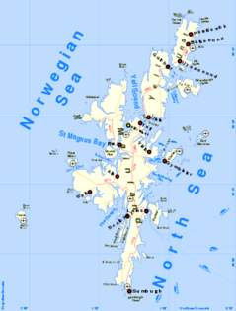
Tomas refused. Summer flowers and birds were his key words for a trip there and so at last in the beginning of July 2016 we went there.

Slide 17
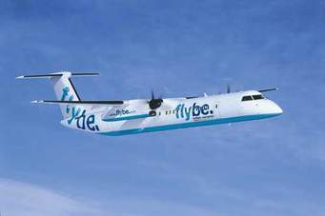
In 2016 I had expected that an ordinary booking site on internet would have taken us there easily but there were no offers from Sweden available. I realised that Stockholm is very ”off” when we only could make the trip if staying at least one night in Madrid or London in both directions!
But with a handful of single tickets we finally made it! From Edinburgh we caught a small plane that took us there arriving very late at night

Slide 18
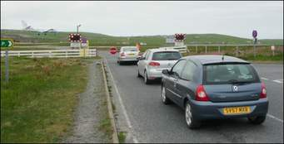
Sumburgh airport is really small – and a dangerous place indeed!
This might look like an ordinary queue at a railway crossing - but NO!
It is a small plane coming down on the shortest runway I have ever seen and the cars will soon cross it!
The runway starts and stops in the Atlantic

Slide 19
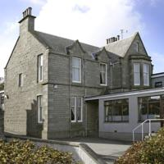
We were installed at The Kveldsroe House Hotel.
The name is obviously half Norwegian, half English. The impression of being in old Norway would follow us around the islands.
So many names inspired of or spelled in clear Norse all over

Slide 20
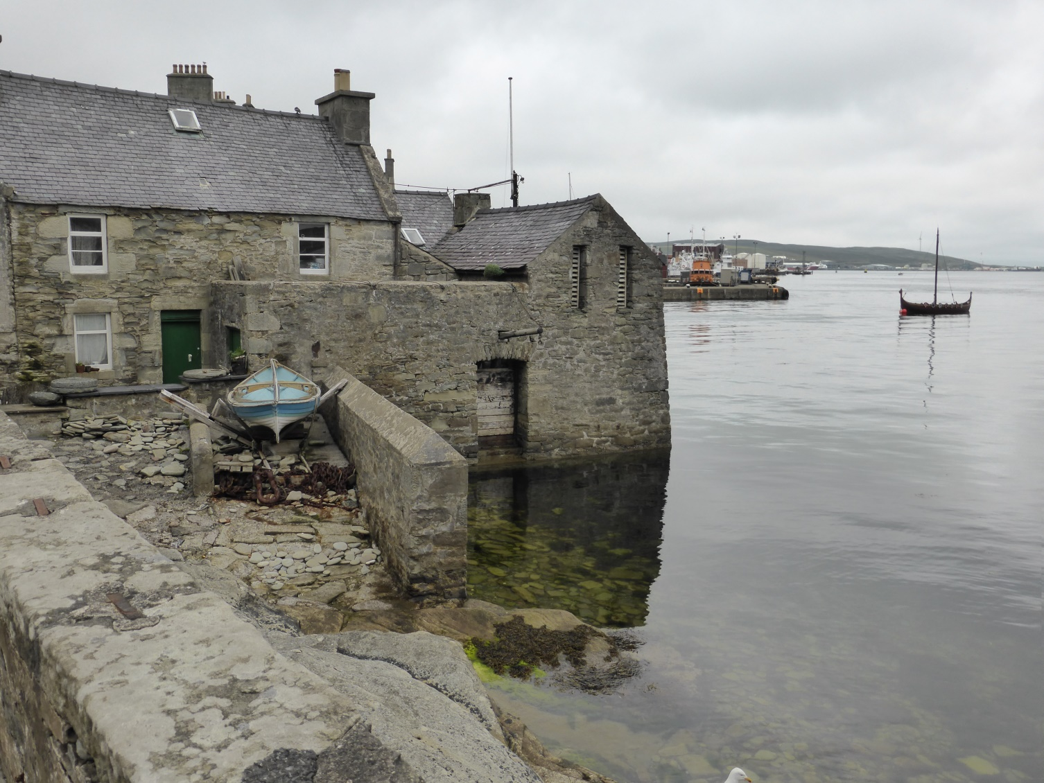
Lerwick, with harbour and big ferries as well as small
fishermen cottages, is the only “burgh” on the islands

Slide 21
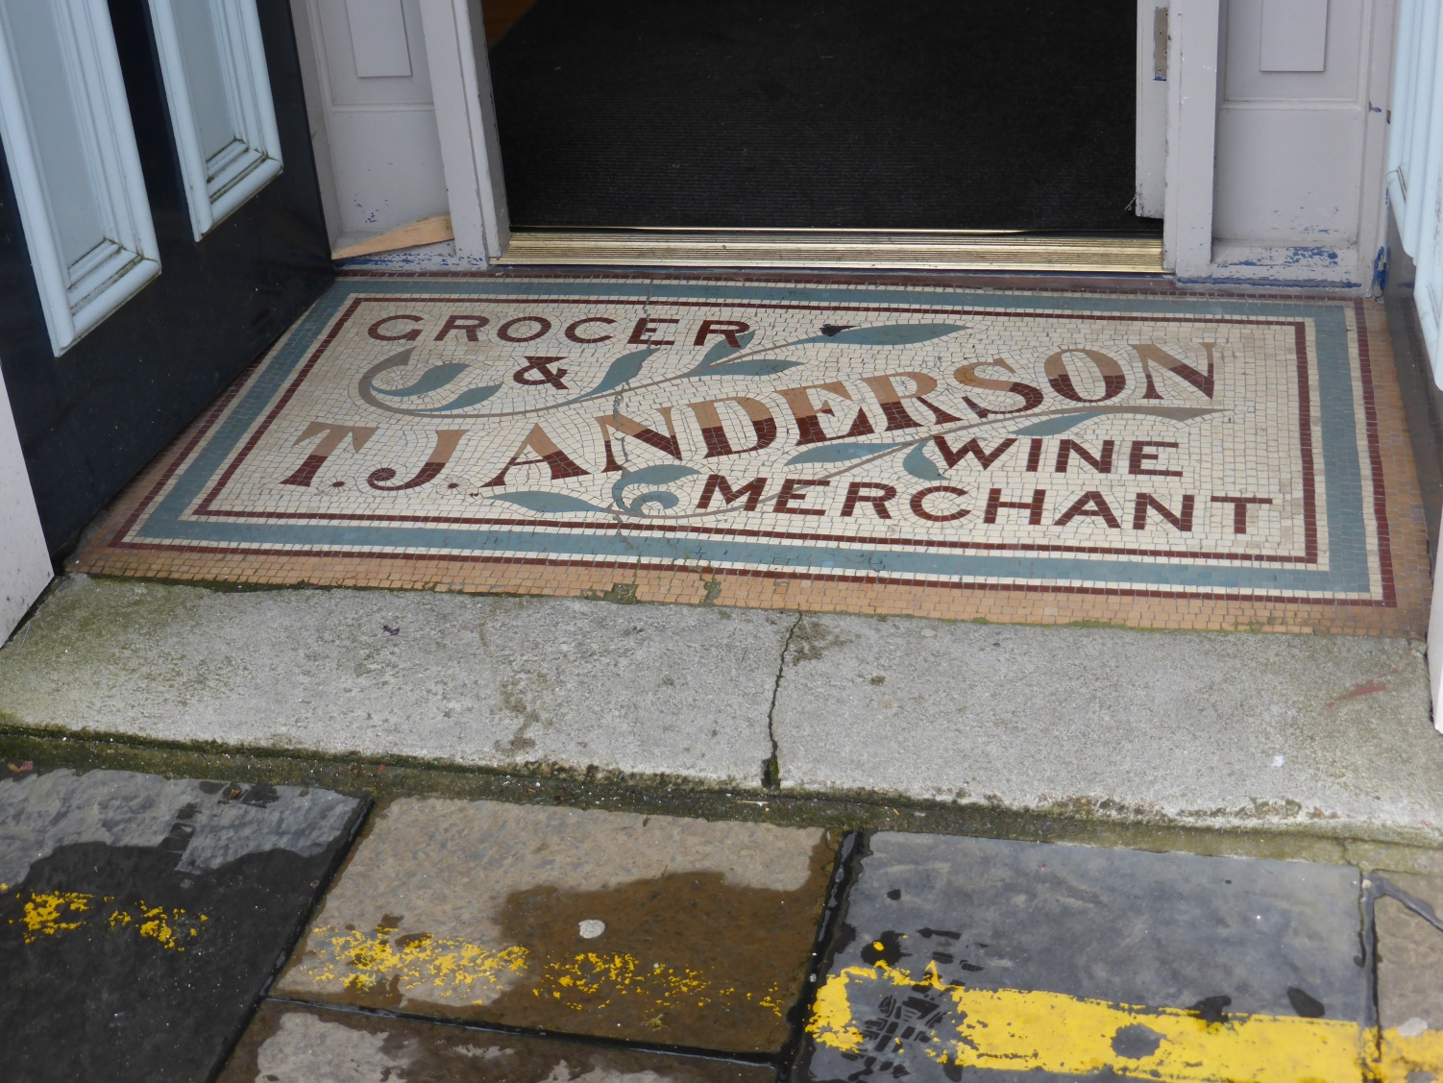
The Tourist office offered other goods

Slide 22
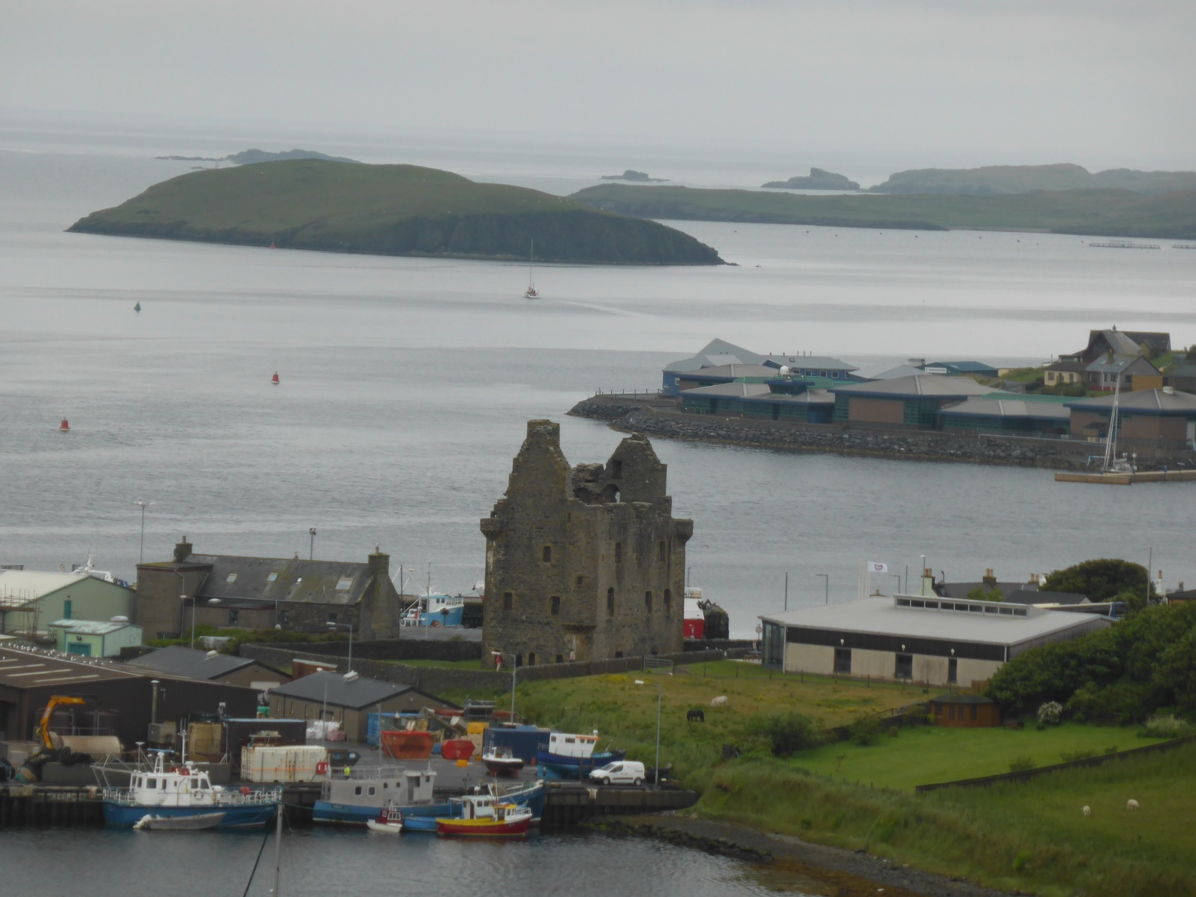
Scalloway, the former “capital” of the islands (until 1708).
During WWII it was the operation base for the Shetland Bus

Slide 23
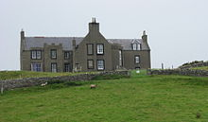
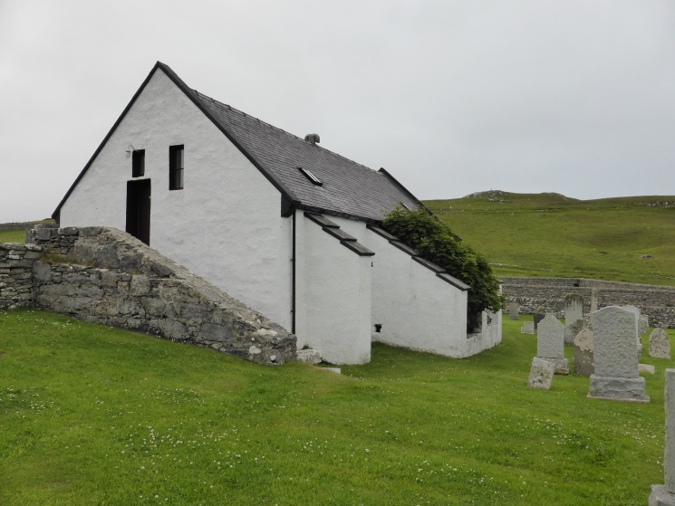
The Shetland Bus was first coordinated from Lunna.
Here the manor and the church. Boats arrived from Bergen and were
pulled over land to the western seas like the Vikings did.
Photo: Aldebaran, https://commons.wikimedia.org/wiki/File:Lunna_House_-_Fra_vest.jpg

Slide 24
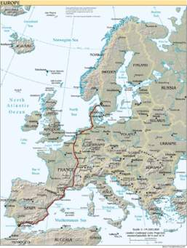
This was the nearest way for intelligence to move from occupied
Norway to London – short but dangerous

Slide 25
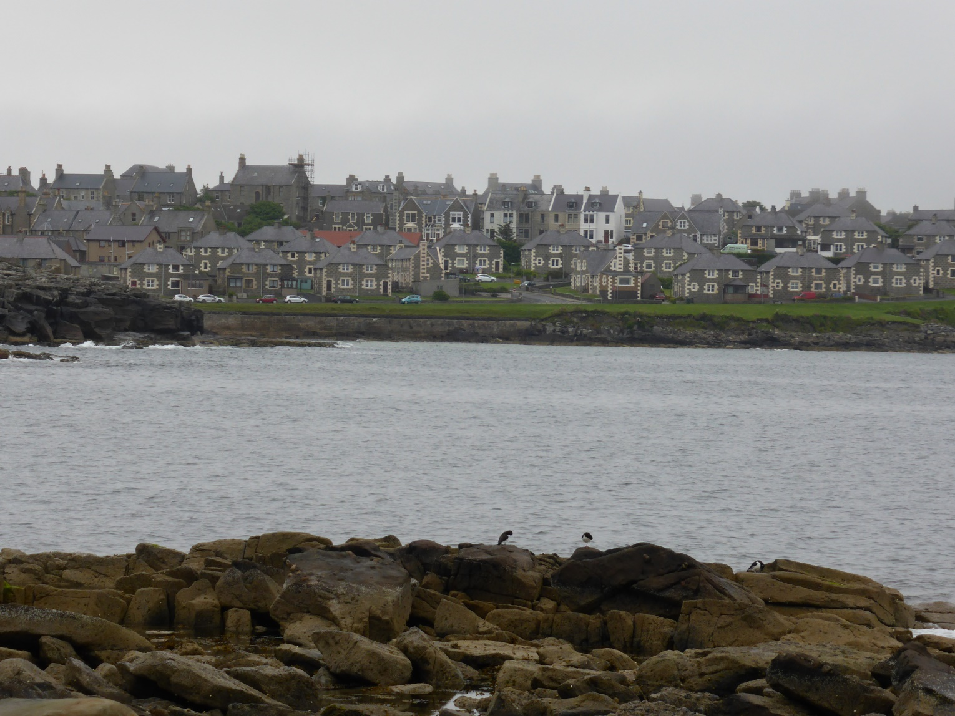
Brae, the second largest settlement in the Shetland islands.
Dependent of the oil industry. Felt very sleepy!

Slide 26
But we also came for the archaeological places and
the long history of the islands …

Slide 27
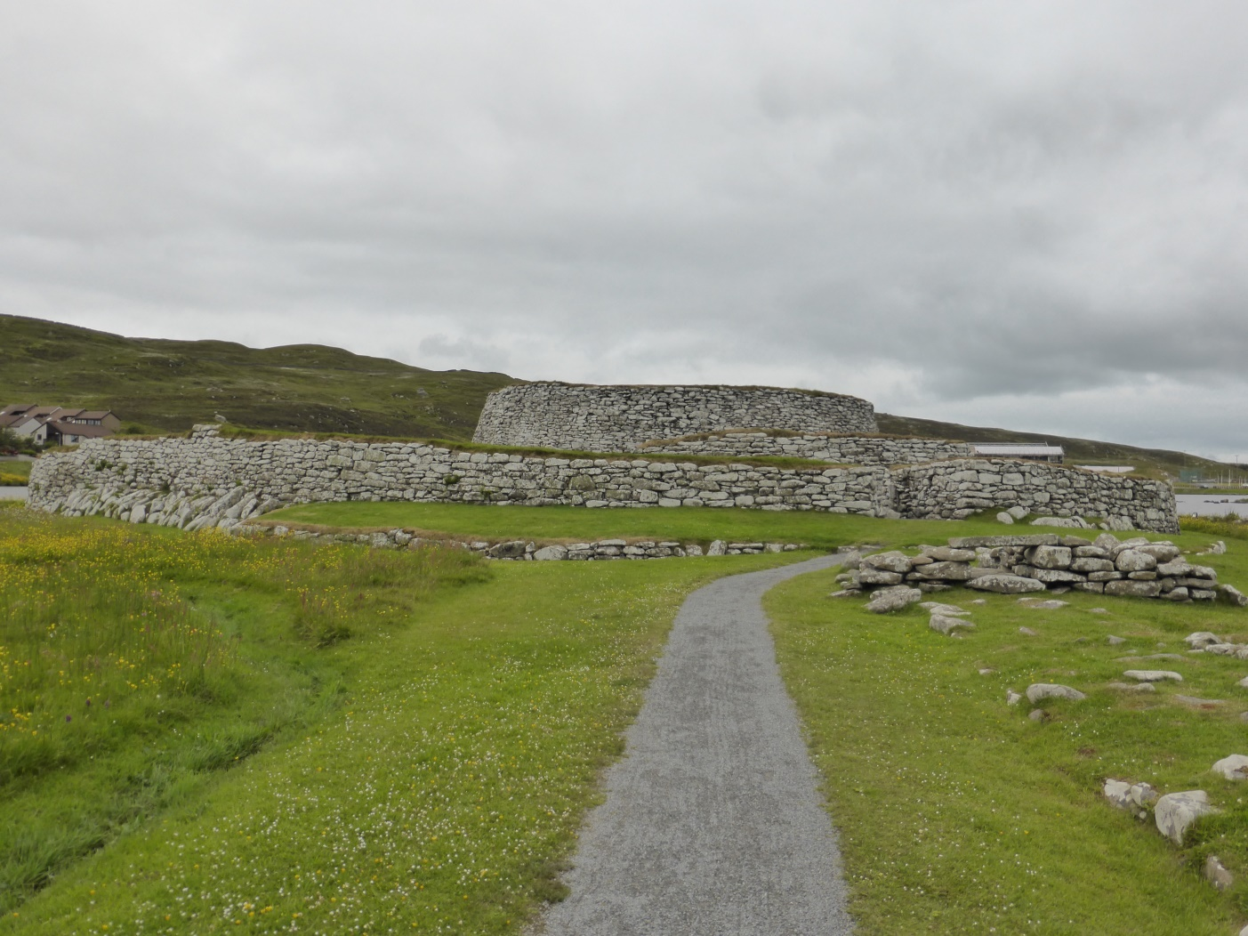
Broch of Clickimin (outside Lerwick) Construction from bronze age
(500 BC) with additions from several centuries after up to iron age
(2nd & 3rd century AD)

Slide 28
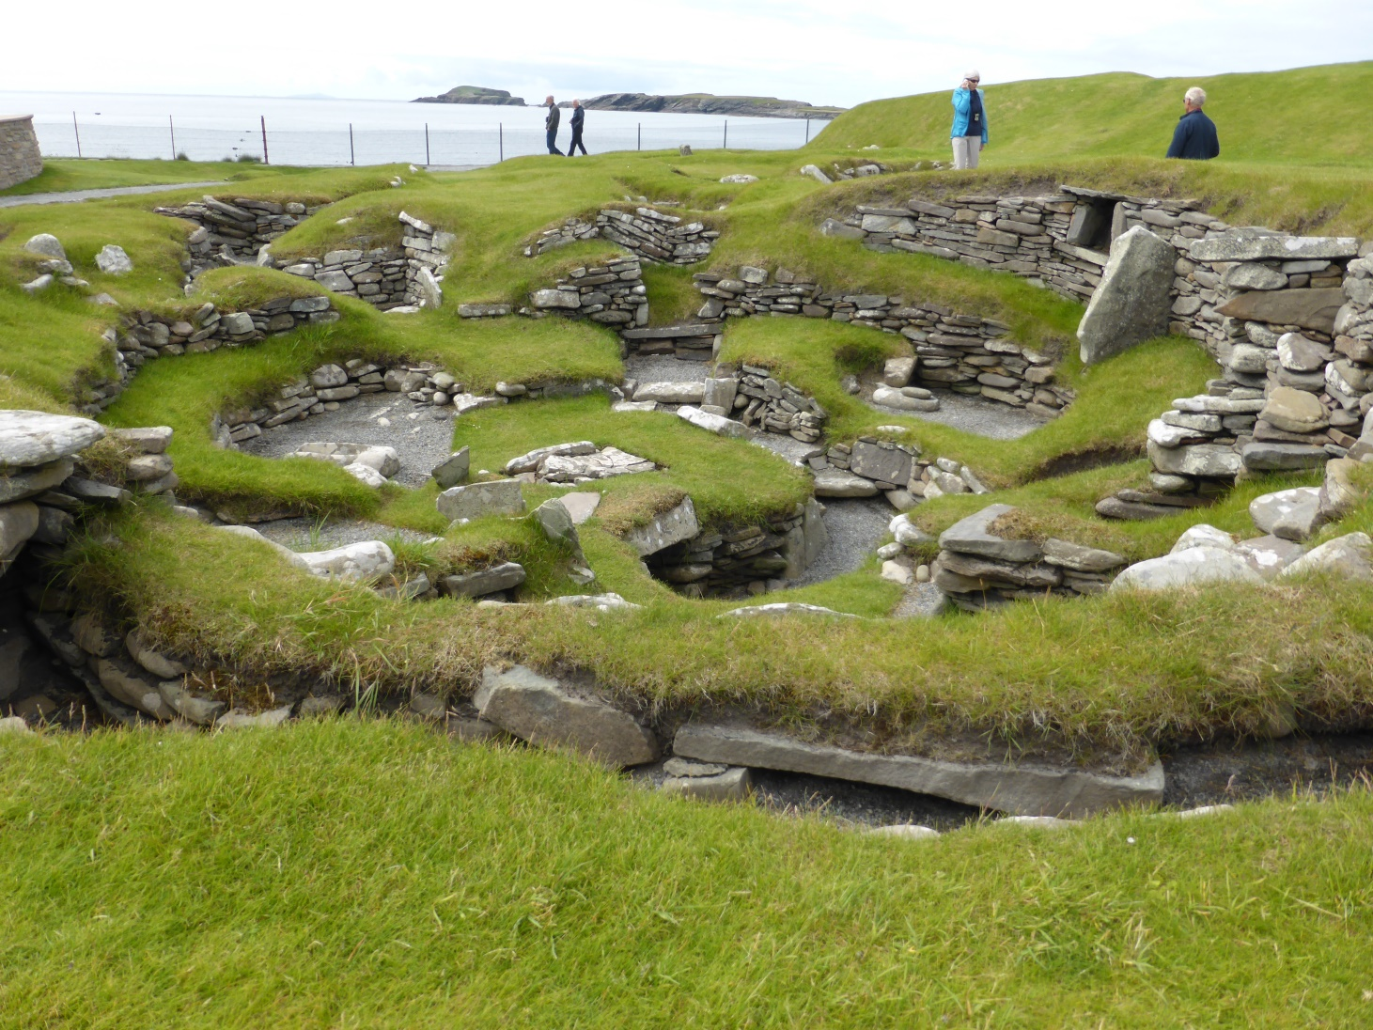
Jarlshof (at Sumburgh Ness) Buried in sand several times.
Excavations show examples of buildings from stone age, early
bronze age and wheel houses from later bronze age, iron age
houses, remaining from Pictish era and , longhouses from the
Viking age and finally remains from a manor house from the 17th C

Slide 29
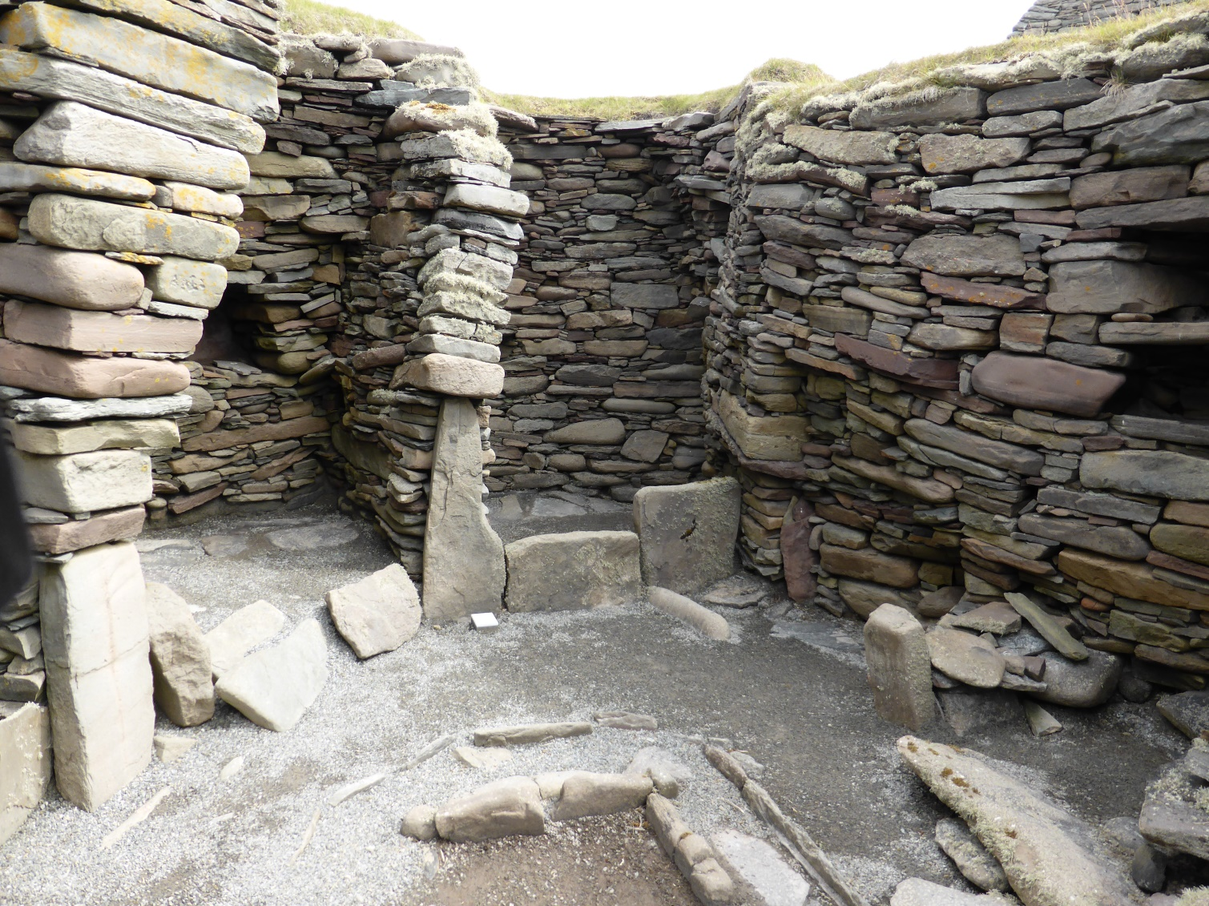
Inside a Wheel House from later bronze age (500 BC).
Several family groups shared a central fire and lived their personal
life in the small chambers in the periphery

Slide 30
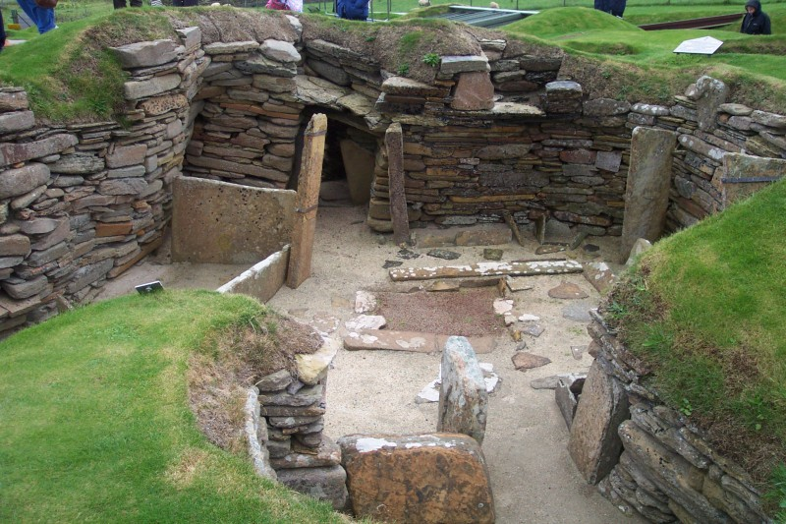
After seeing the even older remains of the prehistoric buildings in
Skara Brea on The Orkney Islands I am sure you can live a comfortable
life with houses and furniture made from lime stone
Photo: Av John Burka, CC BY-SA 3.0, https://commons.wikimedia.org/w/index.php?curid=513393

Slide 31
… and the birdlife ,,,

Slide 32
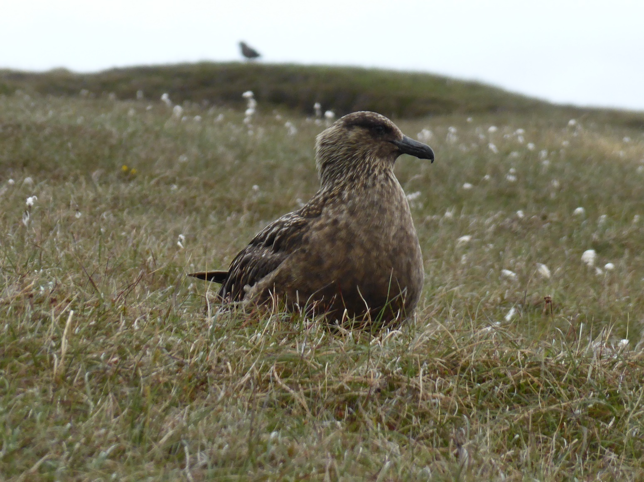
On Unst we came around a herd of Skua,
at least several hundred, maybe more .

Slide 33
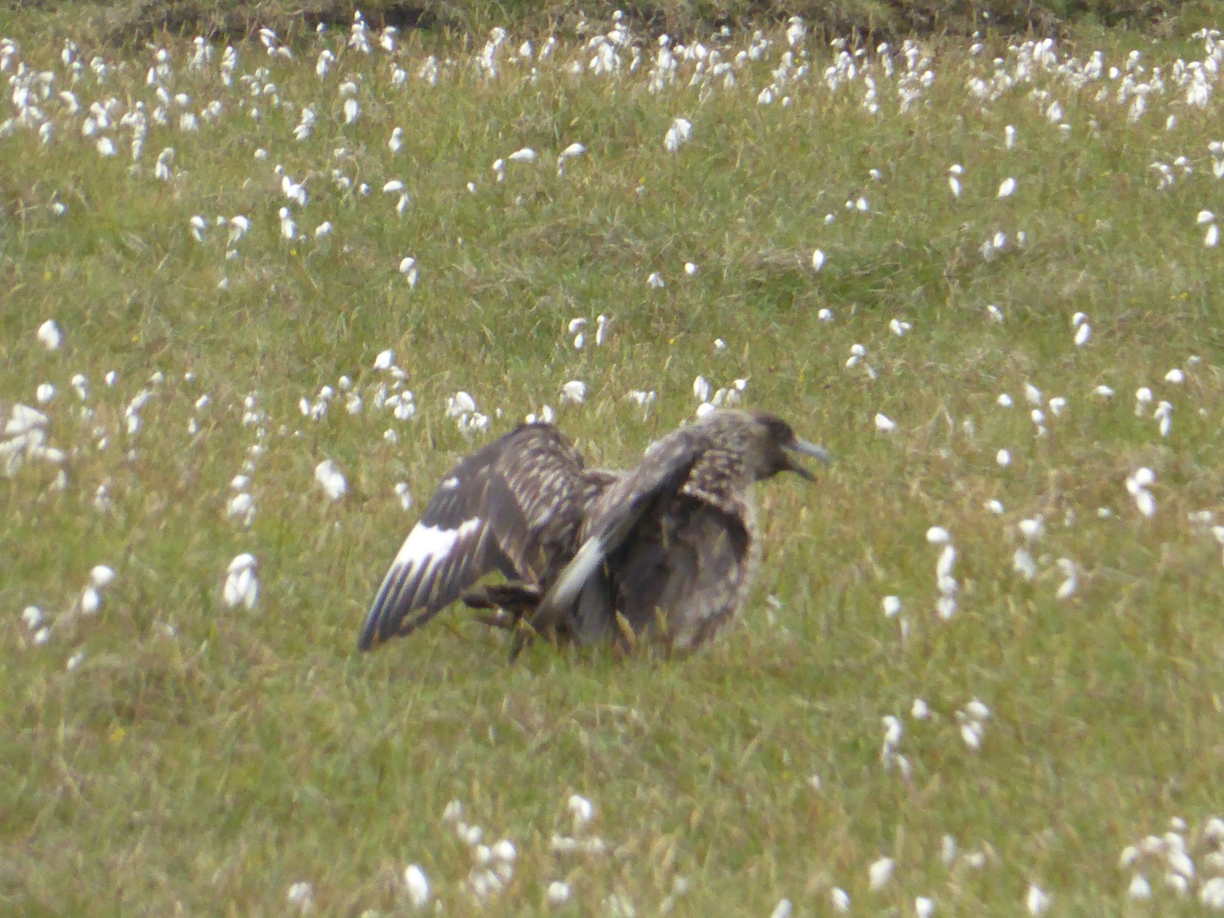
Last time I met a skua was during their breeding period
on Faroe Islands 20 years earlier. That time the birds attacked!

Slide 34
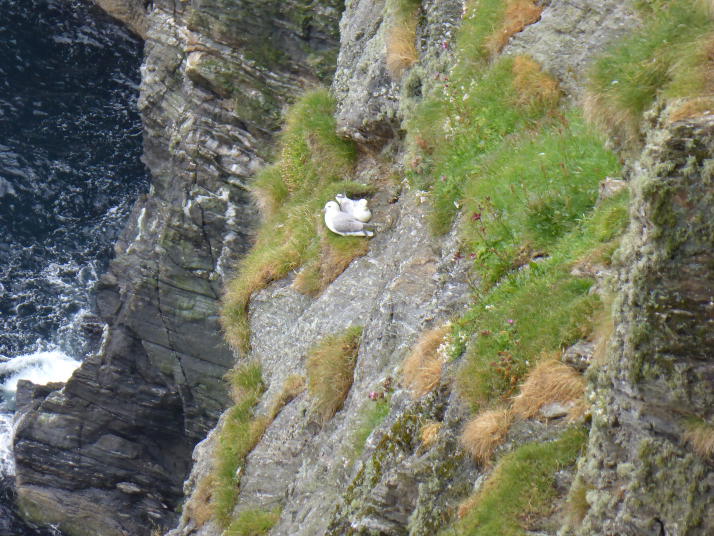
In the bird reserve Hermaness in north Unst birds were
everywhere along the steep hillsides!
Gannets seagulls, sea-swallows and …

Slide 35
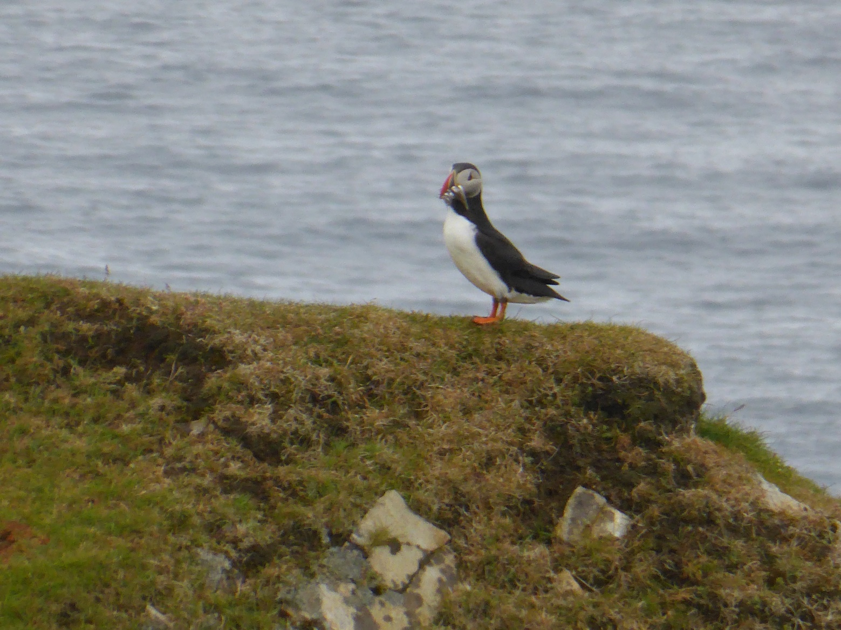
… puffins with a full mouth of fish …

Slide 36
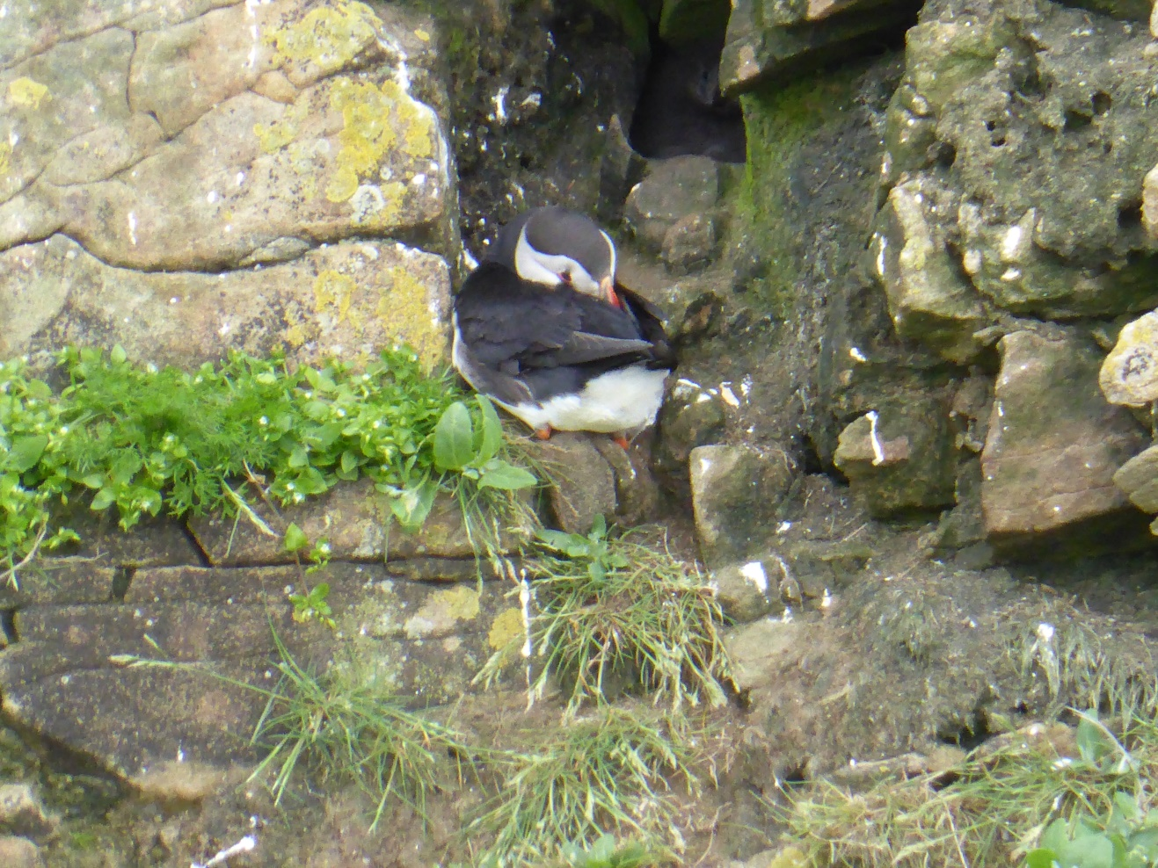
… or sleeping outside their nests

Slide 37
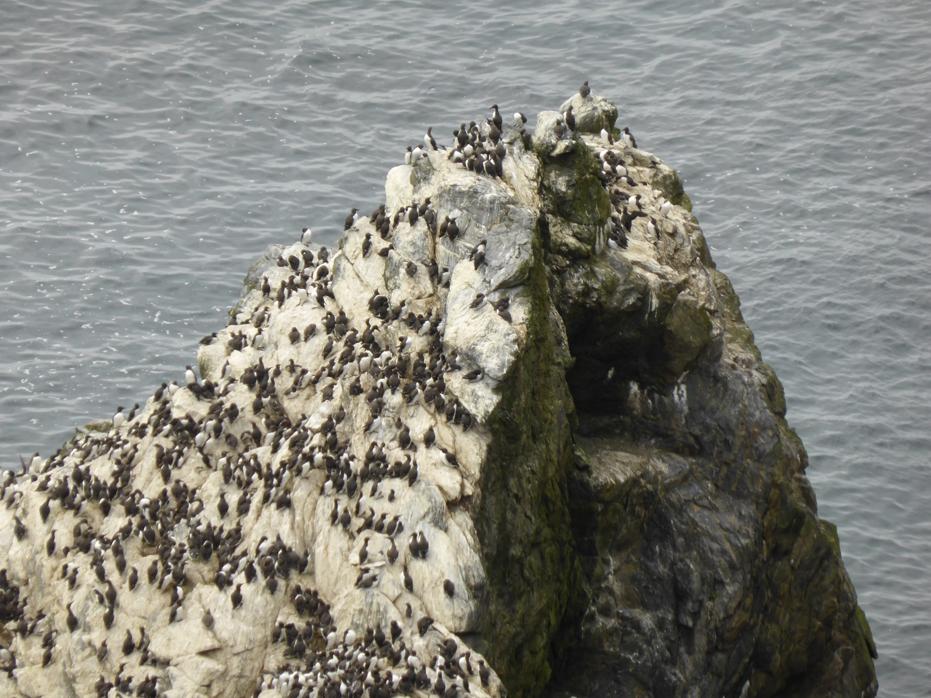
At Sumburgh lighthouse in the south we met them all again and
On this guano covered rock thousands of guillemots …

Slide 38
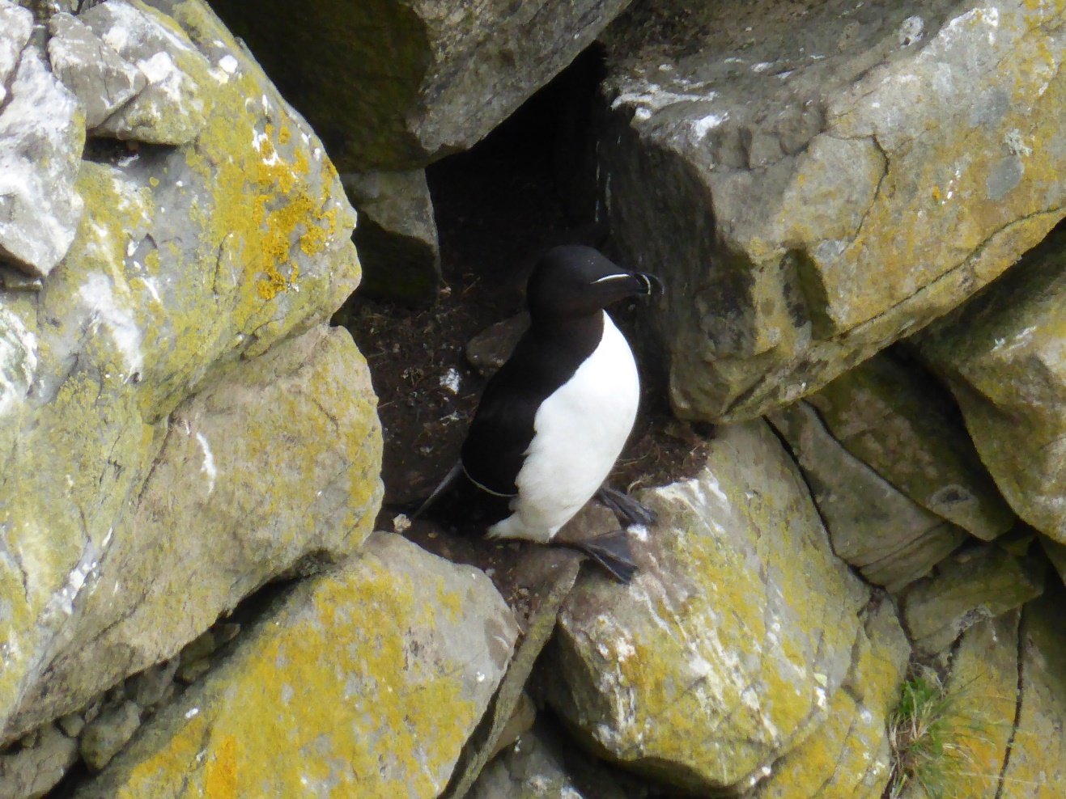
… with their elegant costume and brave diving technic

Slide 39
… and the other animals …

Slide 40
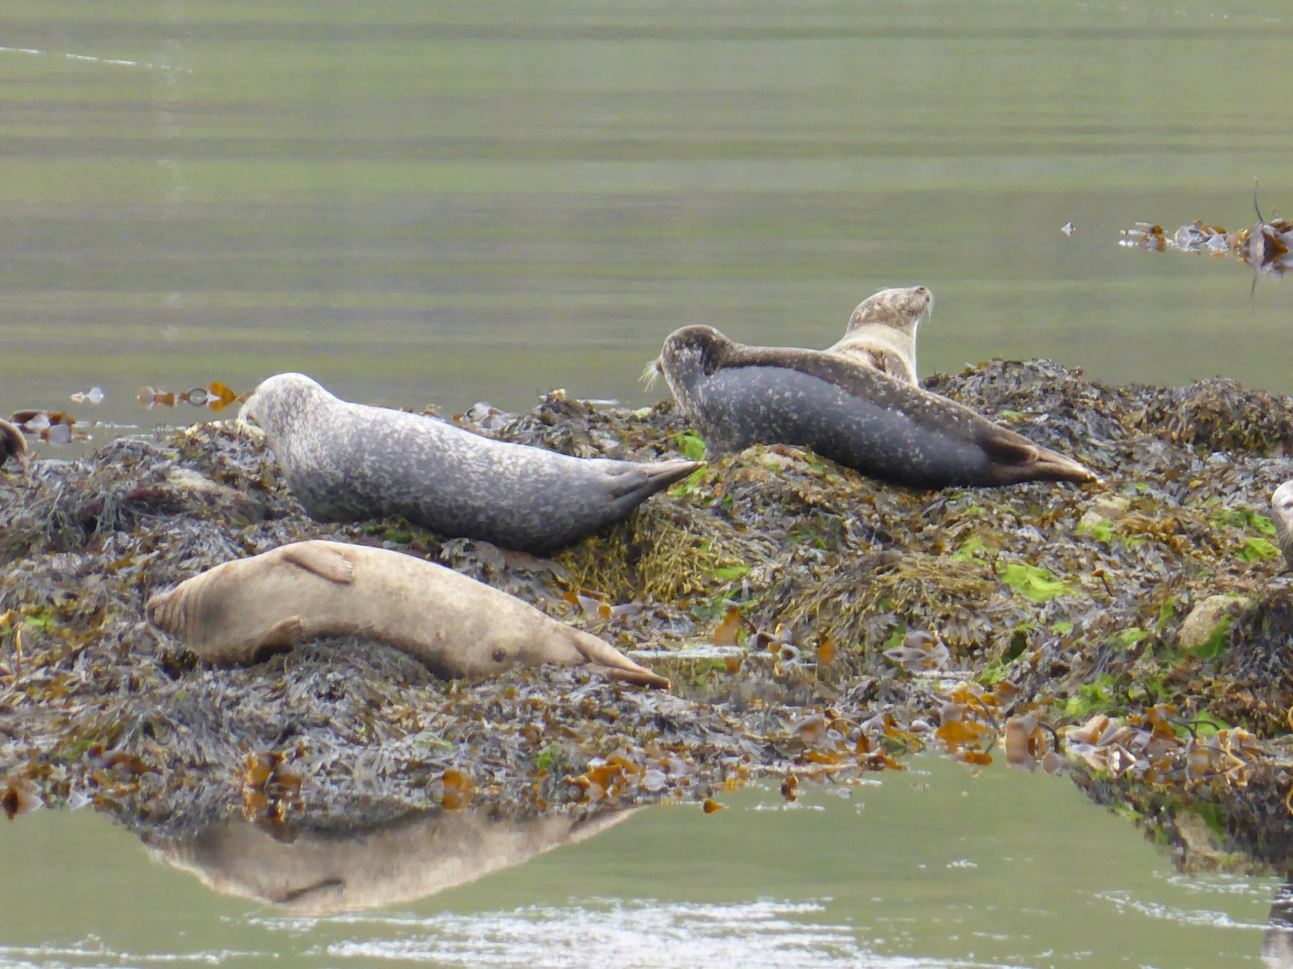
First of all seals – everywhere. Even outside Tesco.
Seals were obviously hated by the local population as we
saw children hitting them with stones on order by old fishermen

Slide 41
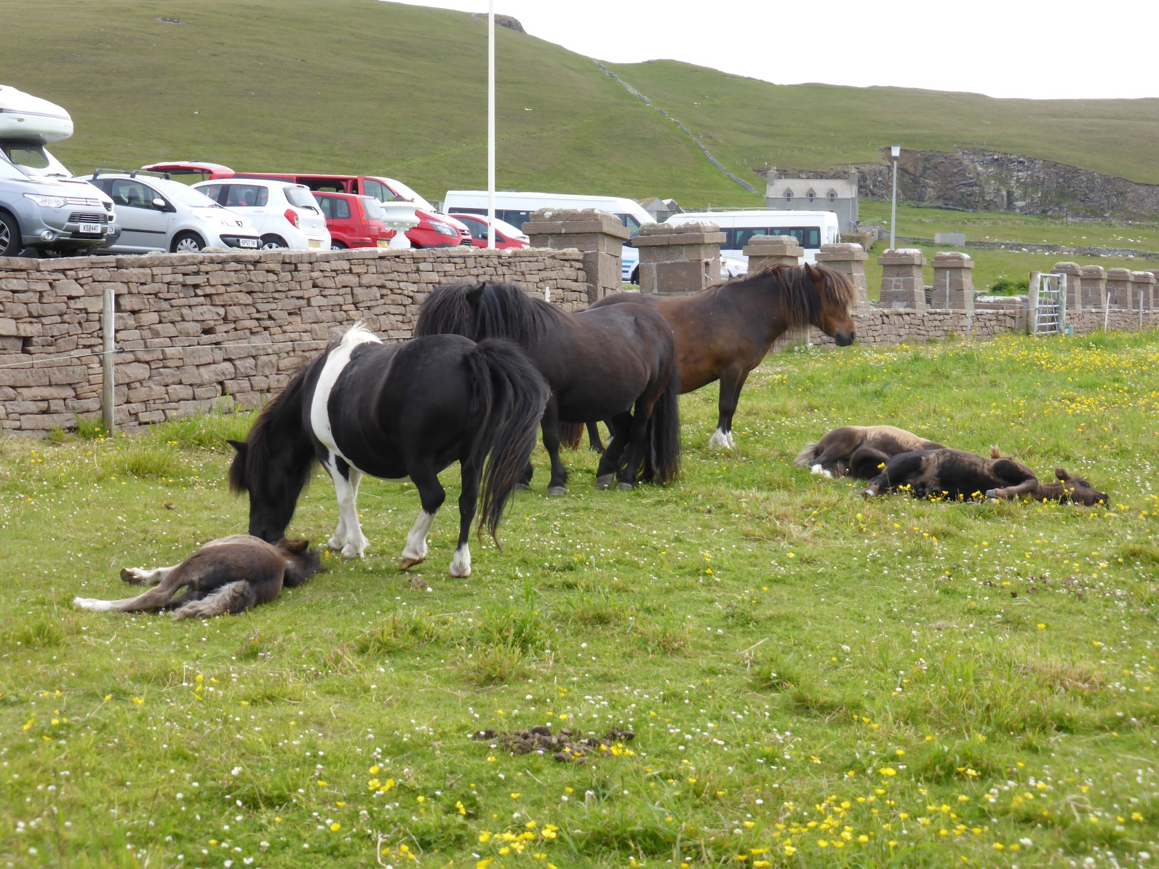
Shetland horses of course

Slide 42
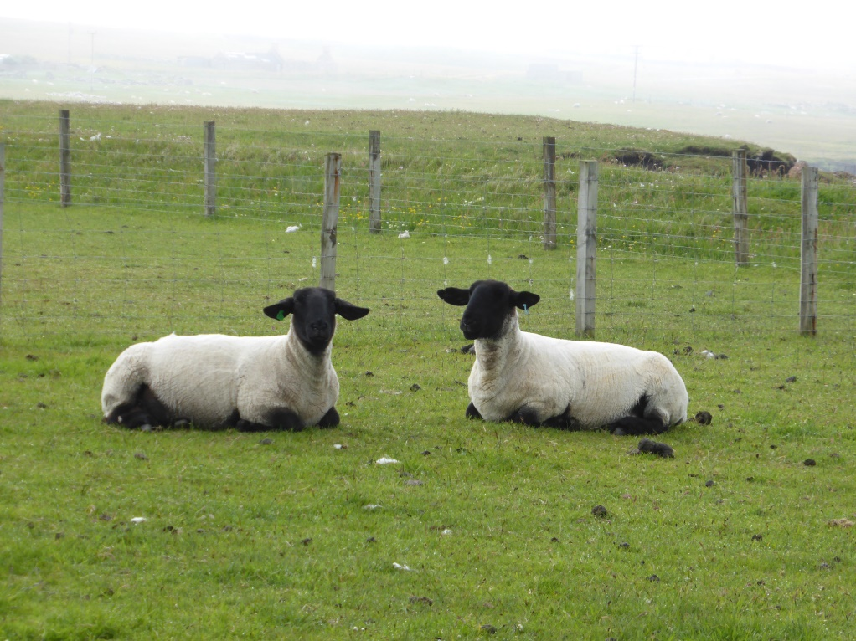
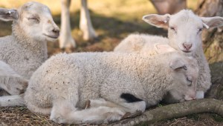
… and many sheep for me to compare with those at home
About 70 lambs this year

Slide 43
… and flowers …

Slide 44
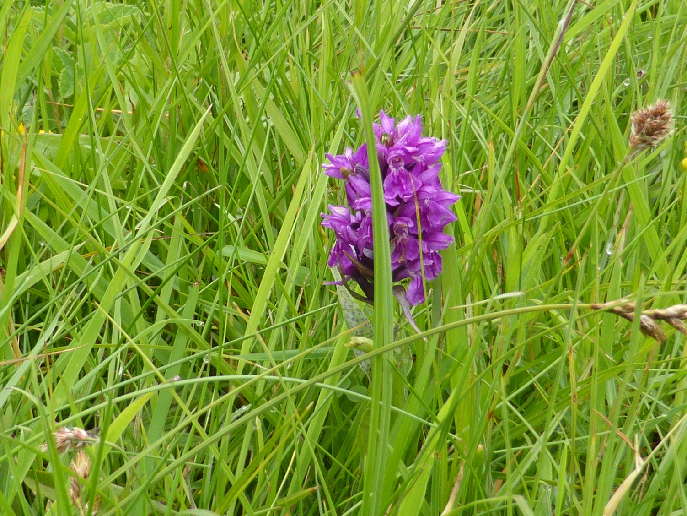

Slide 45
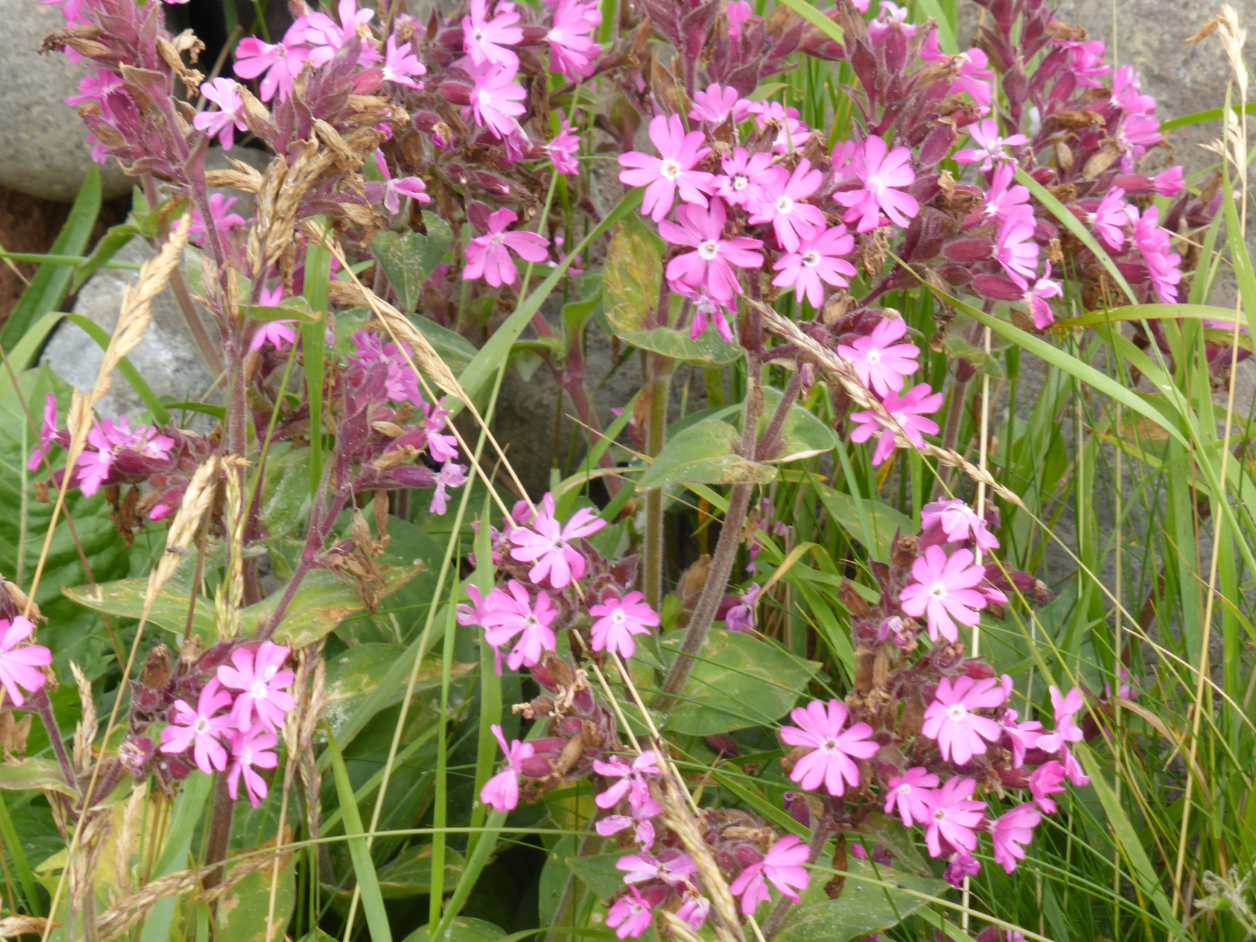

Slide 46
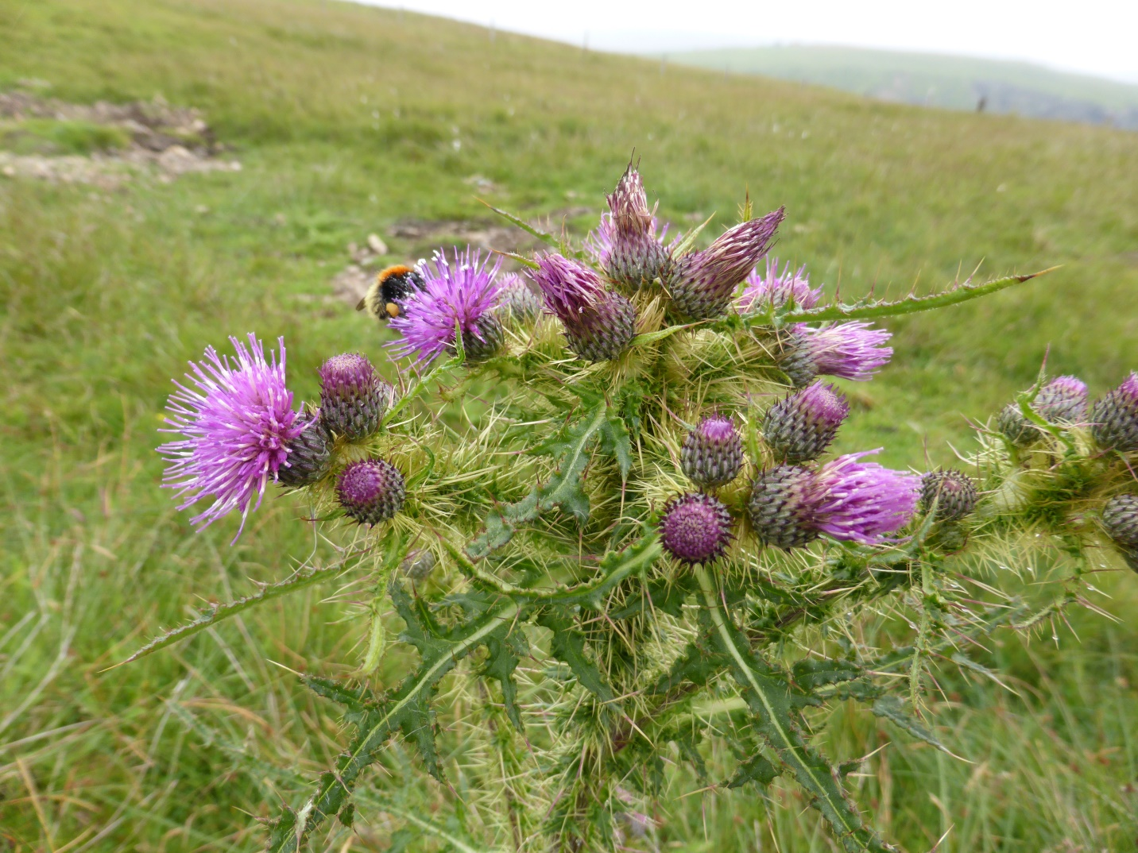

Slide 47
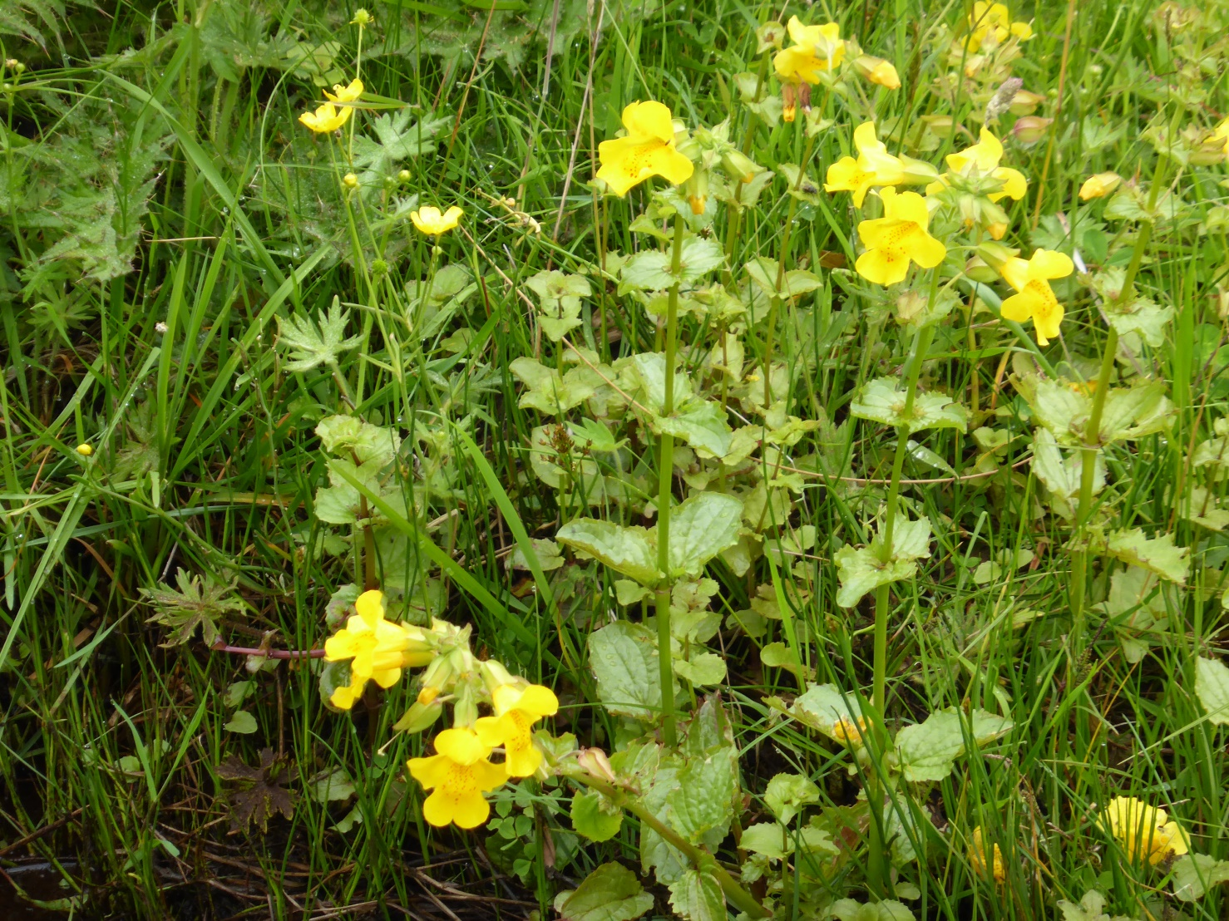

Slide 48
You might have followed the novels and TV series about DI Jimmy Perez, a character from the books by Ann Cleeves. They give a big appetite for the Shetland area in my opinion.
By coincidence I happened to fall into an unexpected story partly set on The Shetland Island. The characters even stayed at the same hotel as we did!
As I know the novel will be published in English this autumn I take the opportunity to recommend it to readers within GEAR+. We have shared ideas for reading before in our meetings and I find that an excellent idea that ought to be back on the schedule

Slide 49

READING SUGGESTION
Author Lars Mytting:
His third novel, Swim with those who drown, was published in September 2014 and was reviewed as probably the most riveting novel of the year by Aftenposten, Norway’s largest newspaper. Foreign rights are sold to Denmark, Sweden, Germany, Sweden, Estonia, France, Iceland, The Netherlands, Poland and Spain. It will be published in autumn 2017 in the UK and US with the title «The Sixteen Trees of the Somme».

Slide 50
The mocking islands prepared a punishment for me going there.
I knew it!
The last evening a neighbour called and told us that a small tornado had passed over our home.

Slide 51
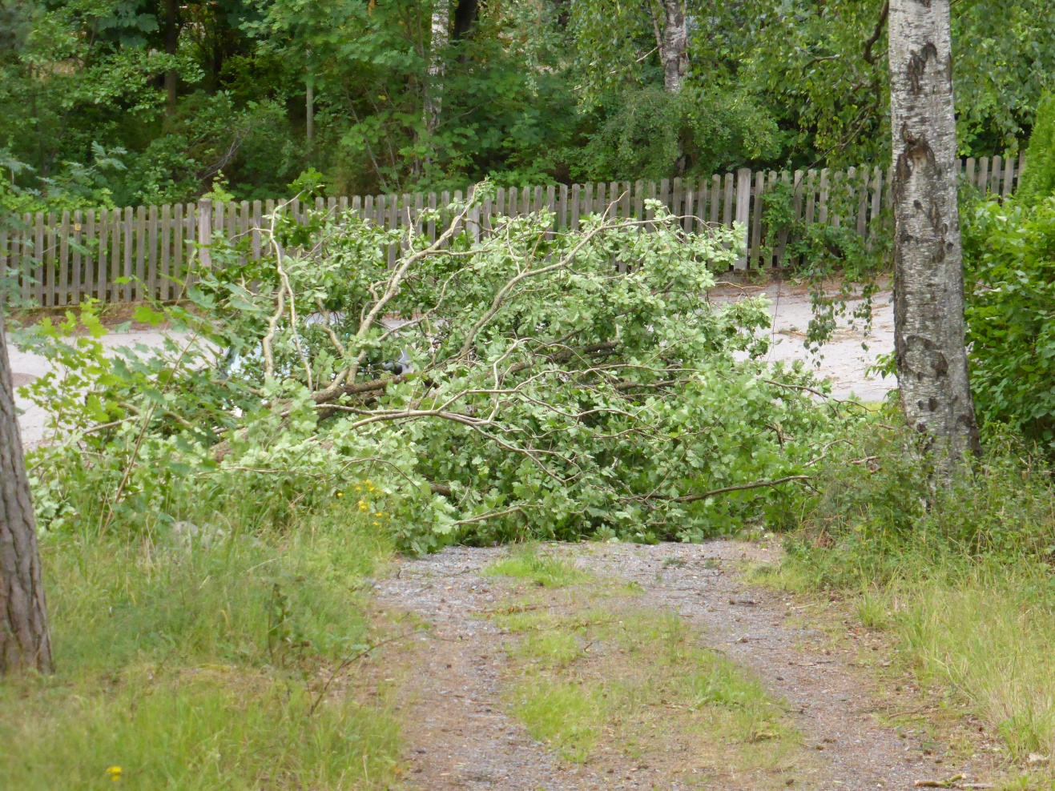
The place where our car usually is parked was full of an oak.
Luckily the car was at the Airport P.

Slide 52
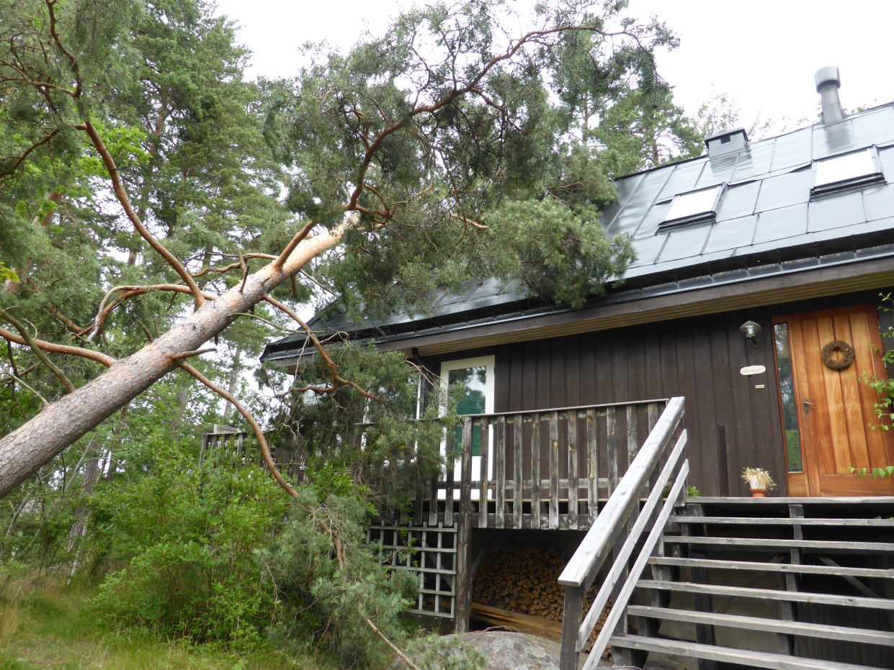
And a most loved pine tree fell over the house
But we were ever so happy that our visit was successful so
we survived this extra adventure

Slide 53
Thank you!

