Slide 1
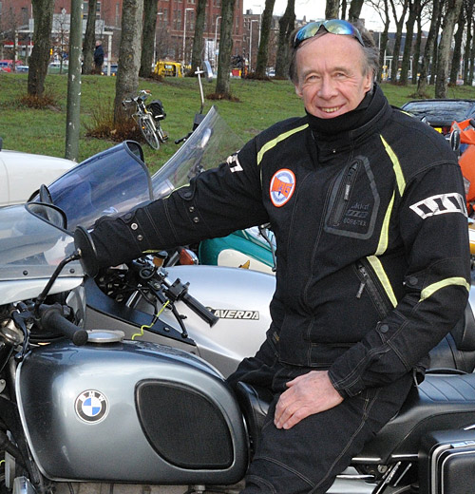
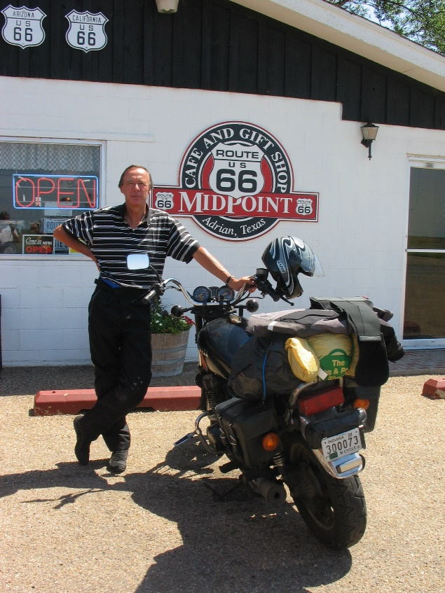
Mortal dangers for Motorcycle Riders the voice of the riders
MidKnight Rider Harold
GEAR+ Reunion
Prague, May 2017
NL: 1974 BMW 90/6
USA:1980 Yamaha 850 XS

Slide 2

# Motorcycles in Europe
Approximately 23.500.000 motorcycle in 31 European countries
Source European Association of Motorcycle Manufacturers ACEM (ACEM)
Country Top-7 # motorcycles
Italy 6.500.000
Germany 3.800.000
Spain 2.900.000
France 1.700.000
Greece 1.600.000
Poland 1.200.000
Great Britain 1.100.000

Slide 3
# Motorcycle fatalities / 1.000 motorcycles
Approximately 4.500 – 5.000 fatal motorcycle accidents in Europe
Source: European Commission statistics
Relatively dangerous
1.000 – 2.000 25 Croatia, 24 Ireland, 23 Poland
2.000 – 3.000 22 Portugal, 21 France, 20 Latvia, 19 Slovakia, 18 Slovenia
3.000 – 5.000 17 Luxembourg, 16 Great Britain, 15 Belgium, 14 Hungary, 13 Estonia
Relatively safe
5.000 – 7.000 12 Greece, 11 Malta, 10 Czech Republic, 9 Germany, 8 Austria
7.000 – 10.000 7 Sweden, 6 Italy, 5 Finland, 4 Spain
10.000+ 3 Switzerland, 2 Netherlands, 1 Denmark

Slide 4
Motorcycle accident incidence
Source: European Motorcycle riders survey
Involved in a motorcycle accident of any nature during the past 12 months?
– both one-sided accidents as well as collisions
Accident incidence Country
Highest incidence: 17 Greece, 16 Austria, 15 Italy, 14 Portugal, 13 Czech Republic
Intermediate: 12 Germany, 11 Belgium, 10 Spain, 9 Great Britain, 8 Netherlands, 7 France
Lowest incidence: 6 Sweden, 5 Poland, 4 Switzerland, 3 Norway, 2 Finland, 1 Denmark

Slide 5
Road infrastructure quality
Source: European Motorcycle riders survey
Road infrastructure quality Country
Lowest quality: 15 Greece, 14 Belgium, 13 Spain,12 Italy, 11 France
Intermediate: 10 Finland, 9 Czech Republic, 8 Sweden, 7 Switzerland, 6 Portugal
Highest quality: 5 Germany, 4 Norway, 3 Netherlands, 2 Great Britain, 1 Denmark
Top-3 problems:
Poor maintenance: potholes, fillings etc.
Road surface itself: top layer material (slippery, repair patches, bitumen fillings etc.)
Markings (painted/patches): signs, lines, warnings, arrows etc.

Slide 6
Top-13 motorcycle accident causes
Source: Dutch motorcycle riders survey
4 Single accident situations Physical injury risk
A Emergency stop to avoid accident (mostly with cars) High
B Oil or fuel on road Medium
C Steering error especially in curves Medium
D Braking error and blocking brakes Medium

Slide 7
Top-13 motorcycle accident causes
Accident condition Physical injury risk
Source: Dutch motorcycle riders survey
9 Colision accident situations Physical injury risk
Sideways
E Car not yielding right of way on intersection High
F Car coming onto road from parking area,, gas station etc. High
Opposite direction
G Car turning left in front of motorcycle High
H Car driving in wrong lane High
Same direction
I Car changing lanes (overtaking, turning etc) Medium
J Car hitting motorcycle from behind stopped for traffic light, yielding etc. Medium
K Car changing lanes in traffic jam Medium
L Car hitting riding motorcycle from behind Medium
M Motorcycle not keeping enough distance to car in front Low
666

Slide 8
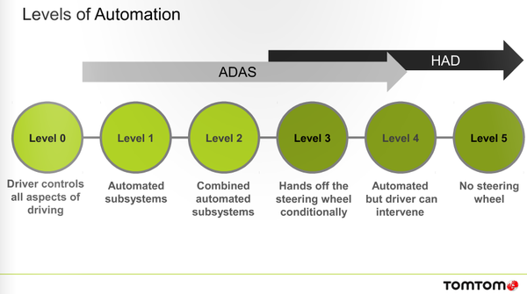
Newest danger: Adas/HAD
Advanced Driver Assistance Systems / Highly Automated Driving

Slide 9
Top-10 Useful innovations
Source: European Motorcycle riders survey
ABS (anti-lock braking system)
Visibility improving helmet (prevention of visor fogging-up through heating or de-humidification)
Monitoring of tire pressure and temperature
Vision enhancement (contrast reinforcement in bad-sight weather conditions)
Brake assist (applying maximum braking pressure in emergency situations)
Linked braking systems (engaging both front and rear brakes also when only one is activated)
Impact-sensing cut-off systems
Motorcycle diagnosis (mechanical and technical problems)
Adaptive front lighting (headlight beam projecting into curves)
Automatic stability control (preventing rear wheel spin and front wheel lift-off)
Main focus: motorcycle technology itself

Slide 10
Top-10 Dangerous innovations
Source: European Motorcycle riders survey
Helmet-mounted display of motorcycle information on helmet visor
Intelligent speed limitation (alert and/or intervene when posted speed limit is exceeded; prevent acceleration over posted speed limit)
Warning and automatic intervention when set cruise control speed is exceeded
Continuous on/off flashing strobe lights for visibility
Real-time rear-view display on helmet visor or windshield
Adaptive cruise control (maintaining a fixed distance to vehicle in front)
Lane departure warning (when changing lanes)
Heads-up display of vehicle information on windshield
Intersection collision avoidance (through vehicles transmitting speed, location and riding direction to roadside beacons)
Curve speed warning (GPS-based warning for too much tilt / speed in upcoming curve)
Main reasons:
- Information overload creates rider distraction
Outside interference takes away rider’s motorcycle control
  Accelerated speed to power out of danger
  Braking in turn = bike straightens and rides straight on

Slide 11
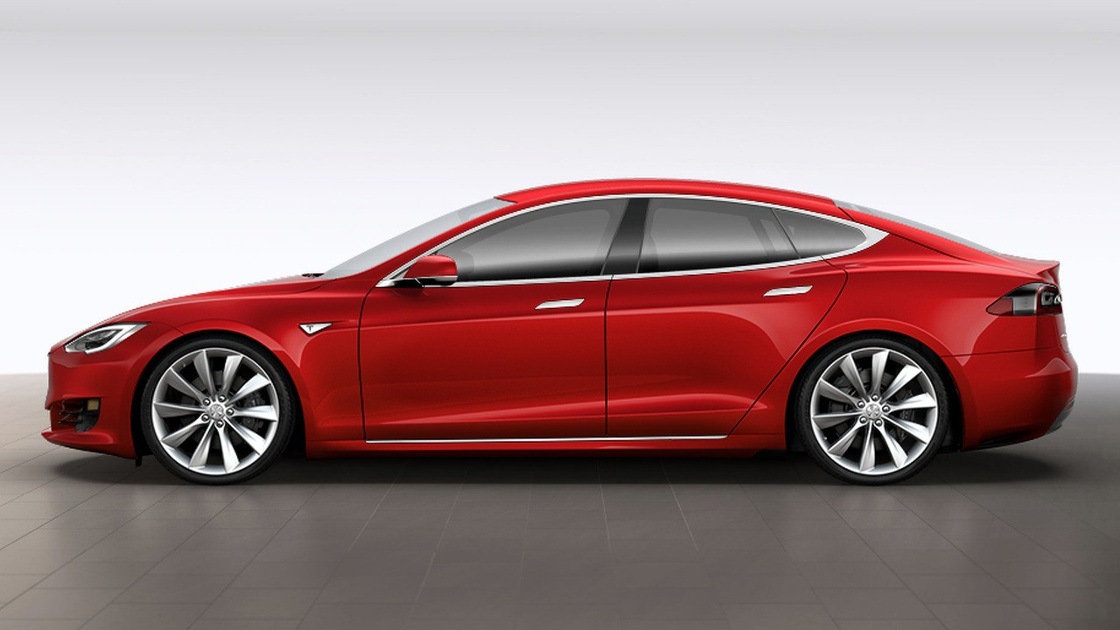

Self-drive pioneer: Tesla (USA)
Tesla promotion:
“Hardware much higher safety level than human driver”
Owner: Elon Musk (PayPal; SpaceX)
100% electric, dual engine, 4-wheel drive, 0-100 k in 2.7 sec
Are self-drive systems safe for motorcycles?

Slide 12



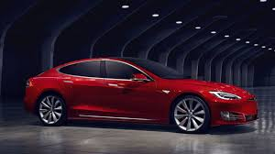

Key change players
FEMA: Federation of European Motorcyclists’ Association
- 17 countries
MAG: Motorrijders Actie Groep (NL)
RDW: Dutch Vehicle Authority (European type approval)
Tesla: “self-drive” pioneer

Slide 13
Future: Connected Automated Driving (CAD)
Detection devices
Camera
Radar
Lidar (= laser)
Systems currently most in use
Blind Spot Monitoring
Forward Collision Alert
Autonomous Emergency Braking
Dynamic Brake Support
Internet-based CAD:
a) V2I: vehicle-to-infrastructure
b) V2V: vehicle-to-vehicle
V2V: Vehicles ‘see’ each other
Automatic:
right-of way / yielding
slowing down / stopping
overtaking / avoiding
V2I: Infrastructure controls vehicle
Automatic:
Speed reduction to prevent speeding
Close-distance driving in rush hour traffic
Power shut-down if in violation
FEMA lobby: mandatory car V2I not mandatory for motorcycles

Slide 14

European approval for car types
European car type approval: centralized, Dutch RDW for Tesla
Car producers: traditional car manufacturers (Volvo, Mercedes, BMW, Audi etc)
newcomer: Tesla (USA)
outsiders: Google, UberTaxi, Samsung
Discrepancy: theory = assumption: drivers always on the alert
practice = absorped on iPhone or iPad with What’sApp, e-mail etc
Critical: motorcycle detection and reponse of car’s hardware and software
Motorcycle nightmare: no European protocol for testing with motorcycles

Slide 15
Tesla danger example
Tesla Model 2 & 3: equiped with 360 degree surround vision
8 camera’s
12 ultrasone sensors
front radar
feature: autopilot self-drive passing on highway
Tesla Model 1: software upgrade with autopilot self-drive passing feature possible
➔ however: no 360 degree surround vision…….!

Slide 16
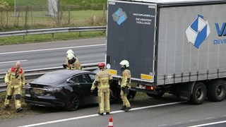
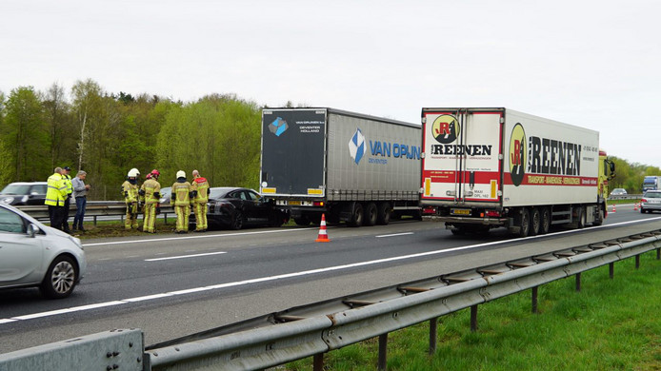
Tesla Didn’t ‘see’ the truck…….
2017 Dutch highway accident

Slide 17
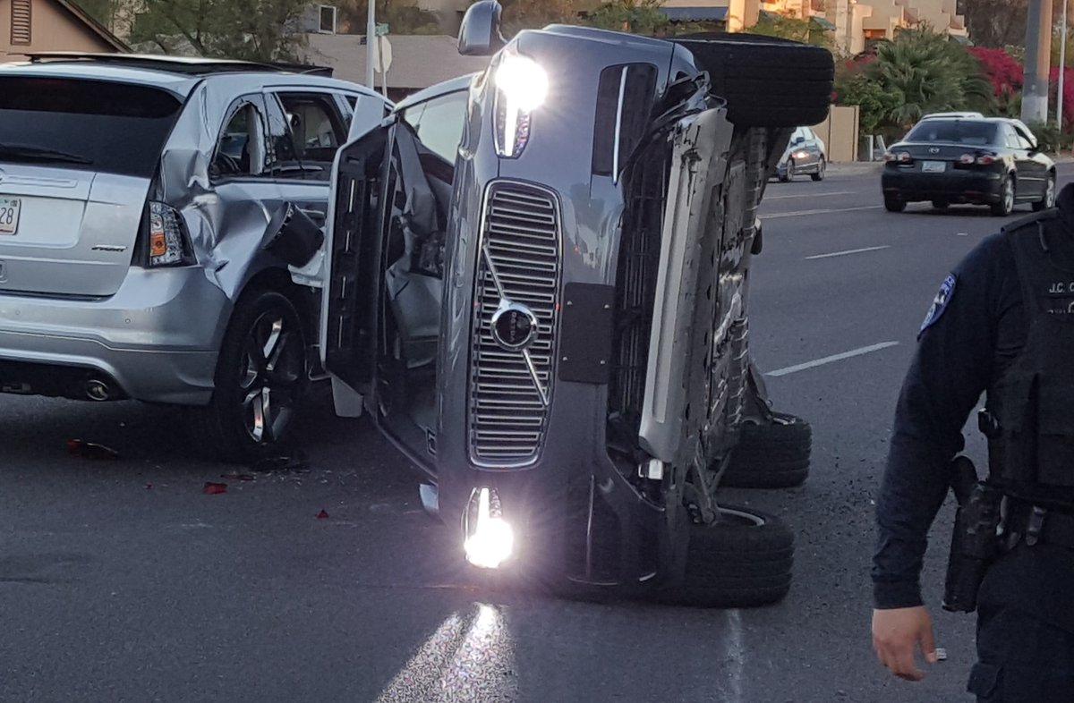
Not only tesla…….
2017 Uber Taxi
self-drive Volvo XS90
in Tempe, Arizona, USA

Slide 18
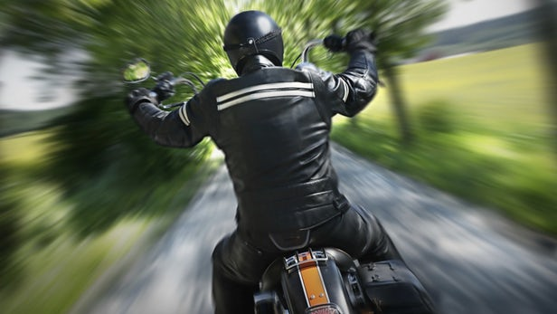
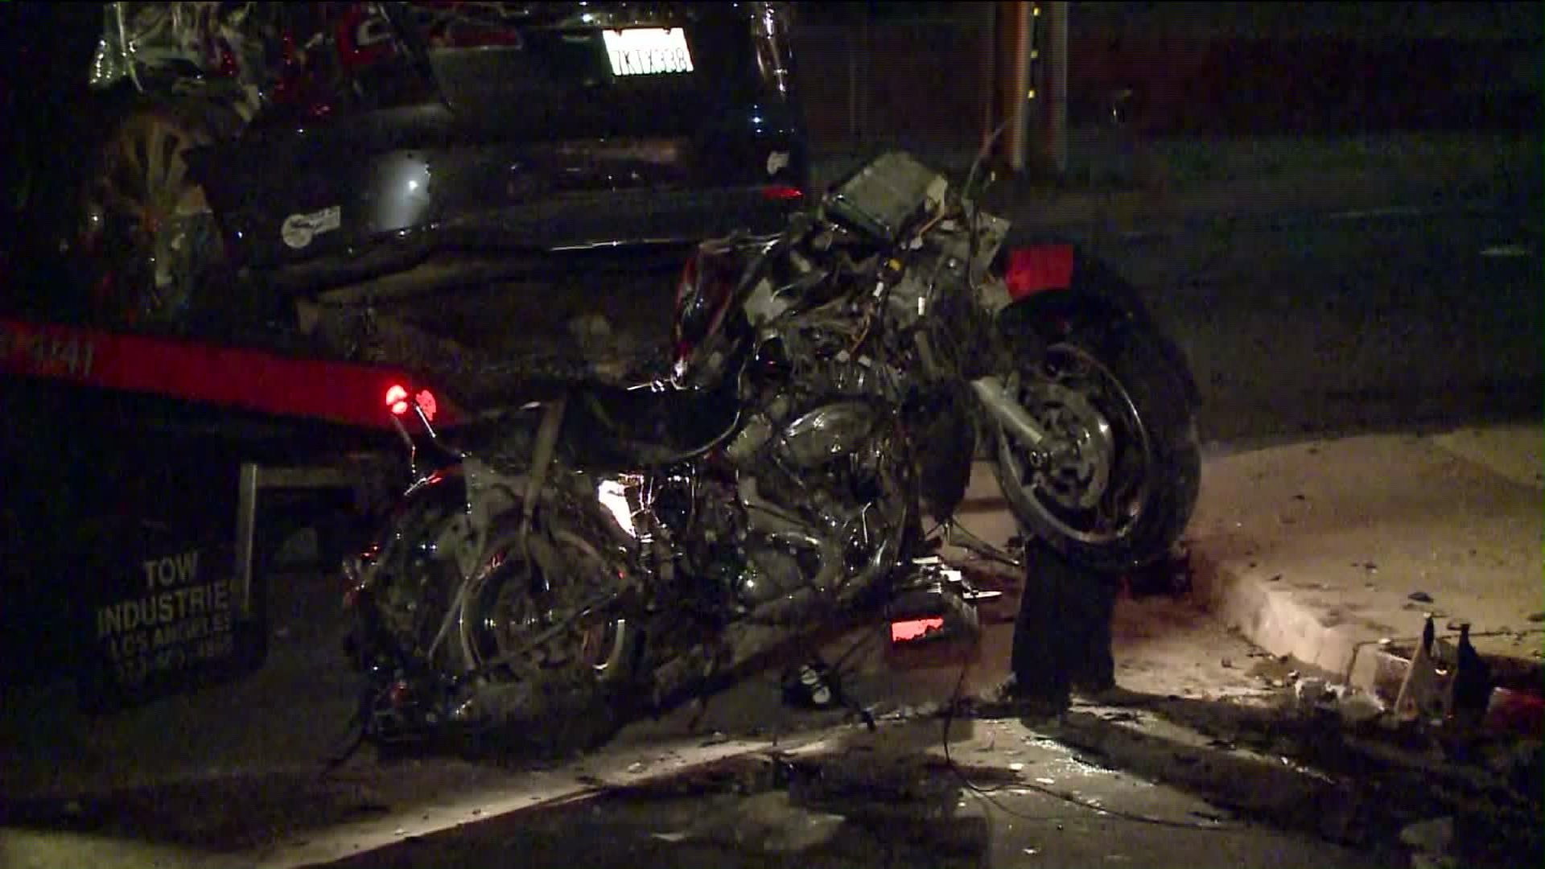
Motorcycle - Tesla Accidents
Norway:
Motorcycle rear-ending raises questions on
Tesla vehicle type approval in Europe
USA:
Tesla Model S driver flees scene after killing
motorcyclist in hit-and-run accident

Slide 19

Required motorcycle safety test conditions
Traffic condition
Sideways
a) Car not yielding right of way on intersection
b) Car coming onto road from parking area, gas station etc.
Opposite direction
c) Car turning left in front of motorcycle
d) Car driving in wrong lane
Same Direction
e) Car approaching from behind
Test conditions
City / highway
Good / bad weather
Low / high speed
Ethical test dilemma:
What failure % is acceptable?

Slide 20

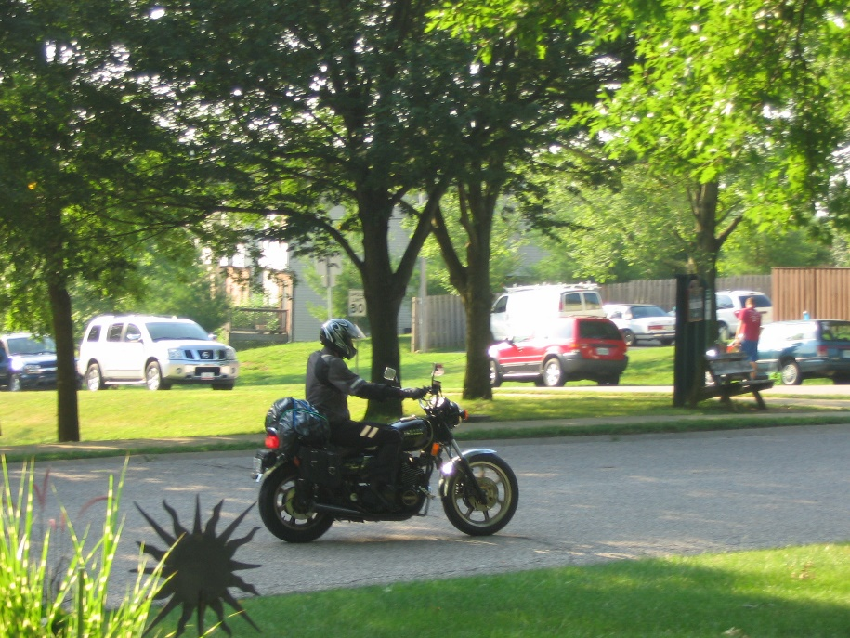
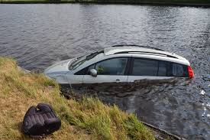
Software ethics: non-neutrality
Mercedes-Benz: “Our top priority is the safety of our car drivers”
MB software programmers make choices:
MB driver wins: MB driver may lose
mother with baby motorcycle Harold car in water
harold
h

Slide 21
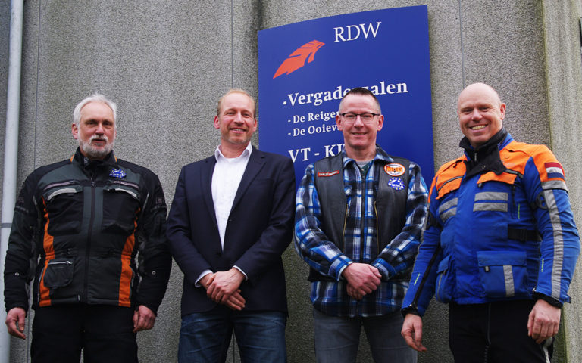
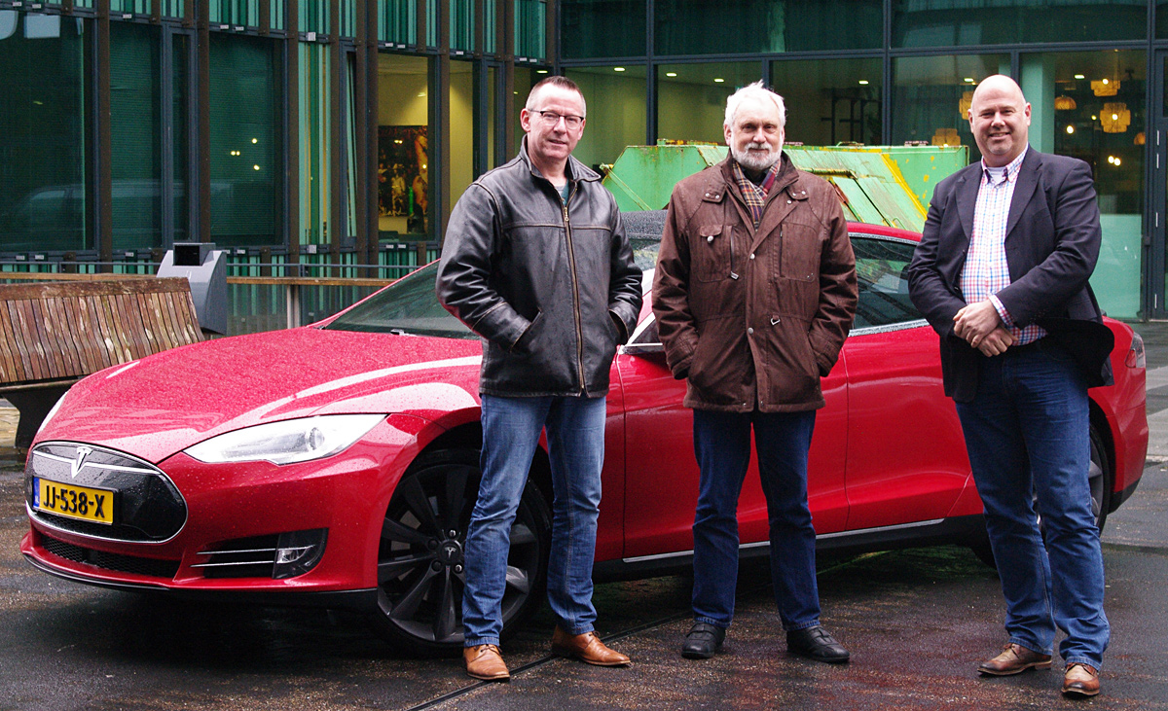
Successful Lobby to make european car type aproval safe for motorcycles
RDW:
➔ ‘Visibility’ of motorcycles critical in future Advanced Driver Assistance Systems
➔ Own test program with different car brands starting in 2017

Slide 22
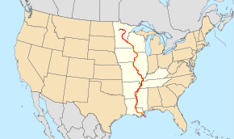

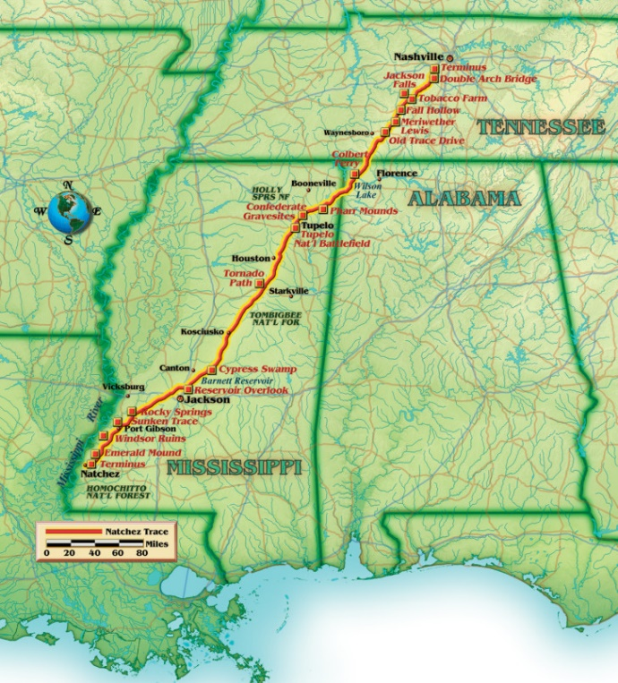
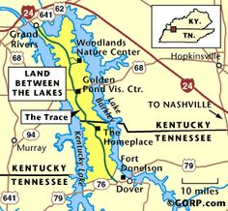

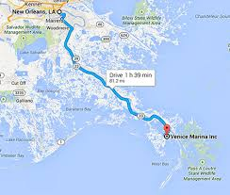
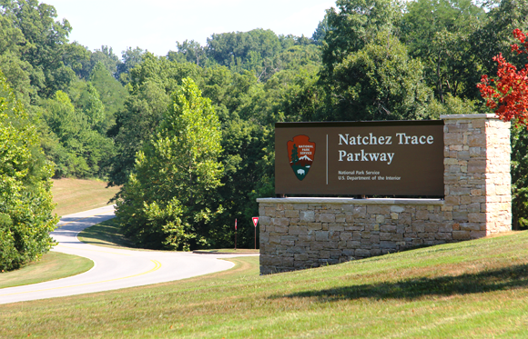
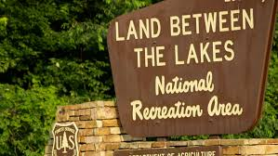
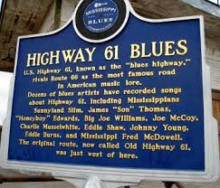
USA 2017 Great River Road and Natchez TRACE – 3.000 miles, 4.500 kms
Bloomington
Indiana

