Slide 1
Wherefrom and Why?
Erik 31. oktober 2015 (70 years)

Slide 2
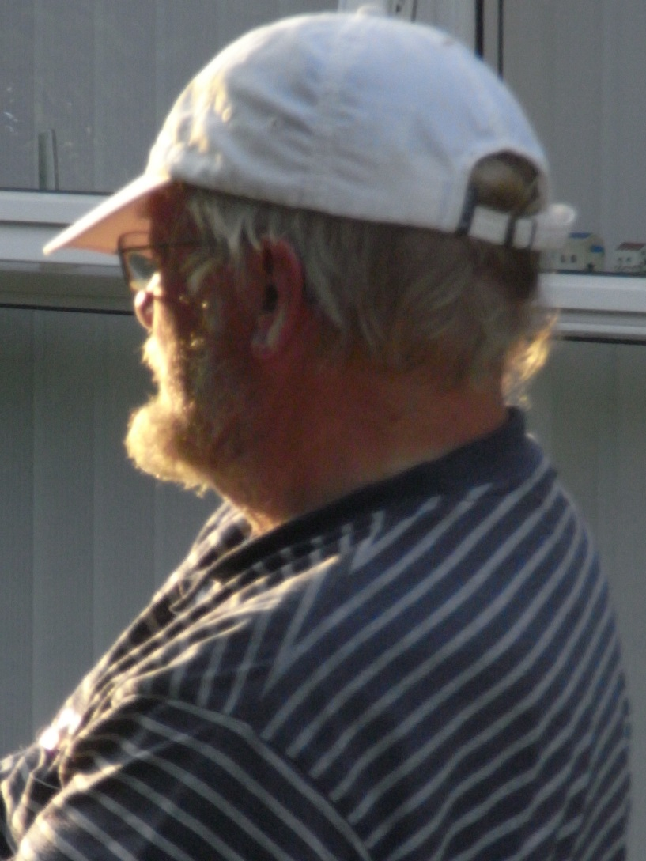
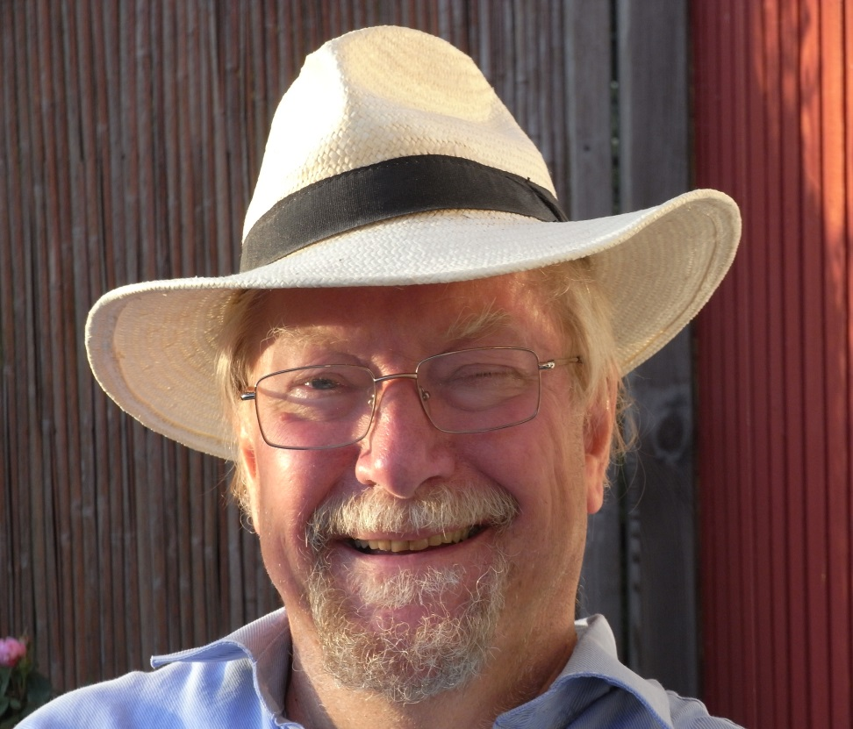
Same man….

Slide 3
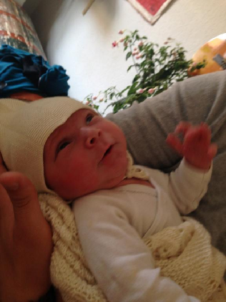
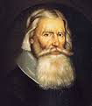
Genealogy is about ancestors
Begin by your parents
What do they KNOW? What do they BELIEVE?
What are they (not) willing to say? Taboos?
Ad fontes!
Letters? Diaries?
Portraits!
Johannes Laurentti Bure
1548-1603
Sigfred Fellenius Blædel
2014 -

Slide 4
What I learned from genealogy?
Life is determined by………..
    Random
    Love
    Society's development/ growth
    The individual mobility
    Light and dark minds
Notes:
Lyse og mørke sind, der omtales i det følgende, stammer fra min farmors breve til min far. Hun refererer karakteristikker endnu længere tilbage i slægten.

Slide 5
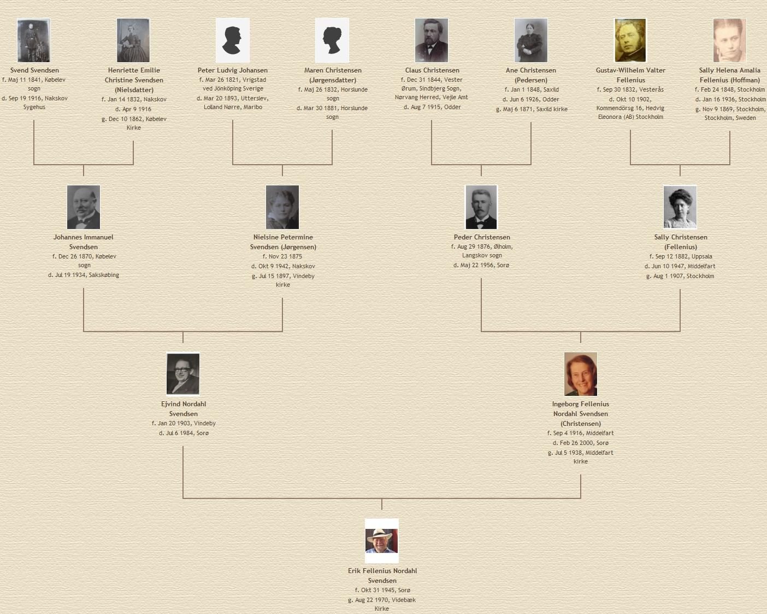

Slide 6
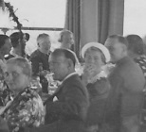
Kirsten the matchmaker, white hat, at her weddling 1937 in Middelfart (Funen): RANDOM and LOVE
At the table her friend Ingeborg was teamed with Ejvind because Kirsten was moving to Sorø (Zealand) and wanted her friend from Middelfart with her.
The 13 years older teacher in Sorø could also do with a young wife, thought the groom, his colleague Erling.

Slide 7
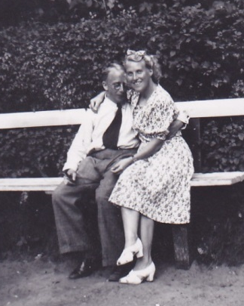
Ejvind og Ingeborg,
Eriks parents
They have in 1940 been married for two years,
has not gotten their first child
not to mention Erik as no. three

Slide 8
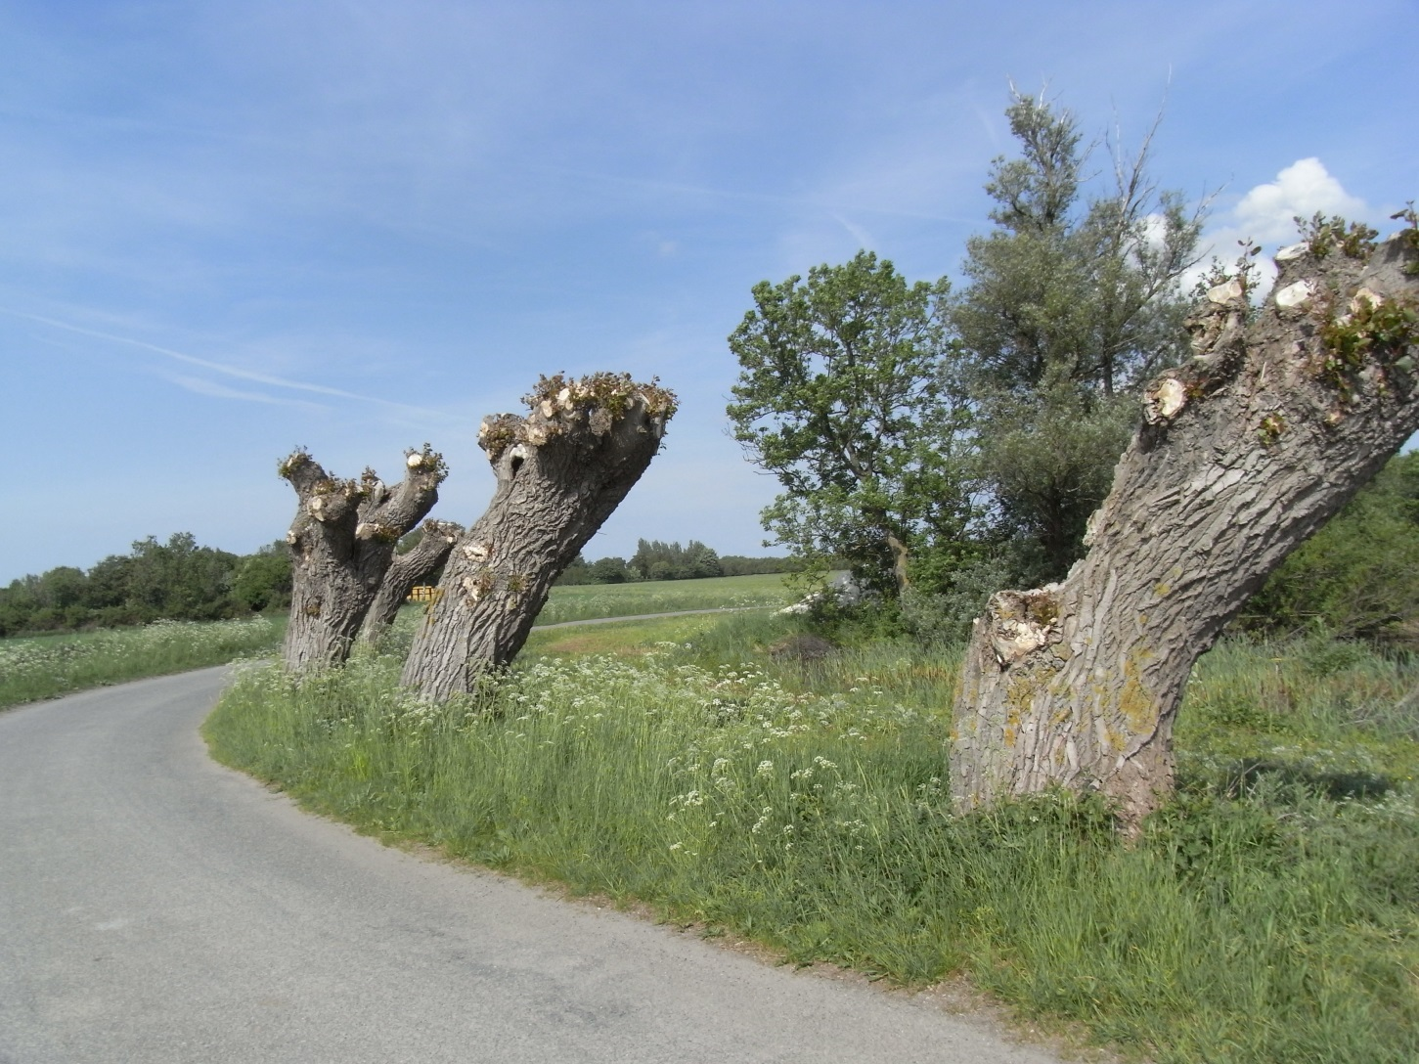
Lets start at Western Lolland

Slide 9
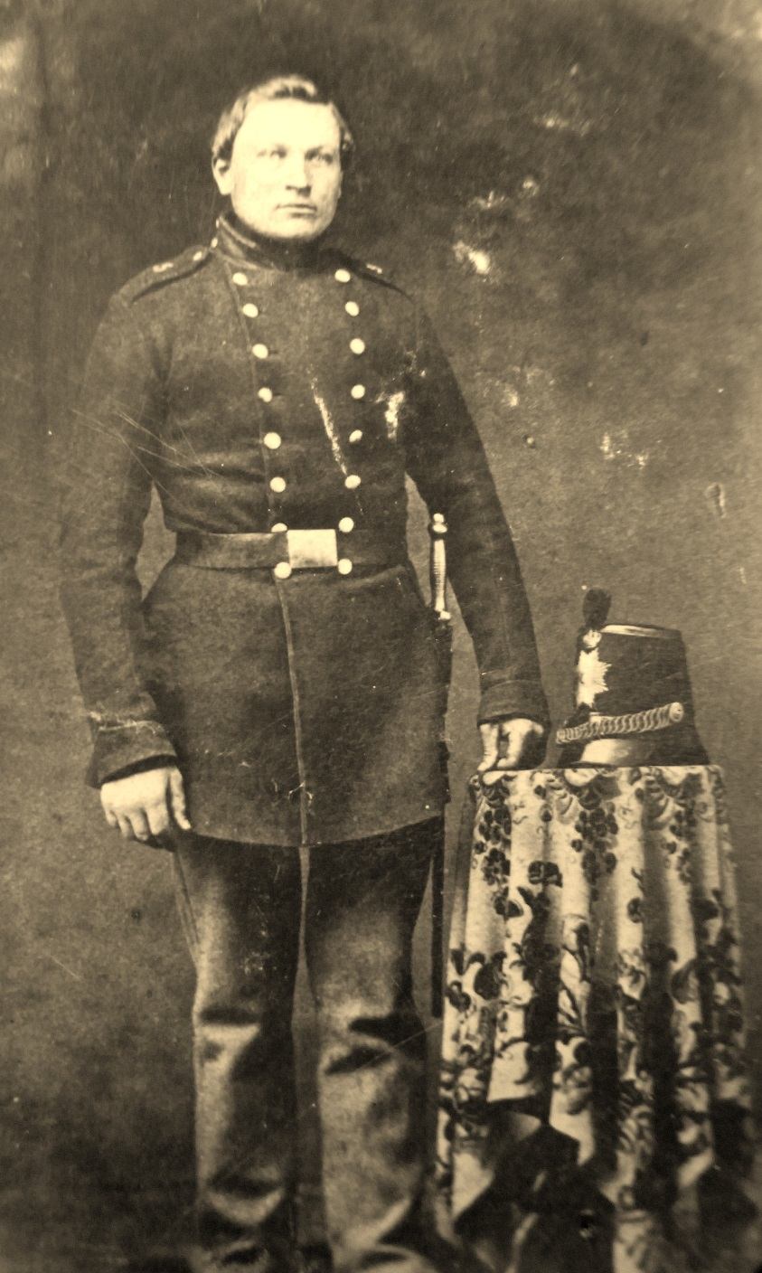
Svend Svendsen,
1841-1916
Eriks Great-Grandfater
Single mother
Lived in poorhouse
Came in foster care
Farm worker
Soldier (his unknown father fell at Isted 1850)
Wounded 17 March 1864 (one month before the "slaughter bench“ at Dybbøl)
Again farm labourer,
always walked badly.

Slide 10
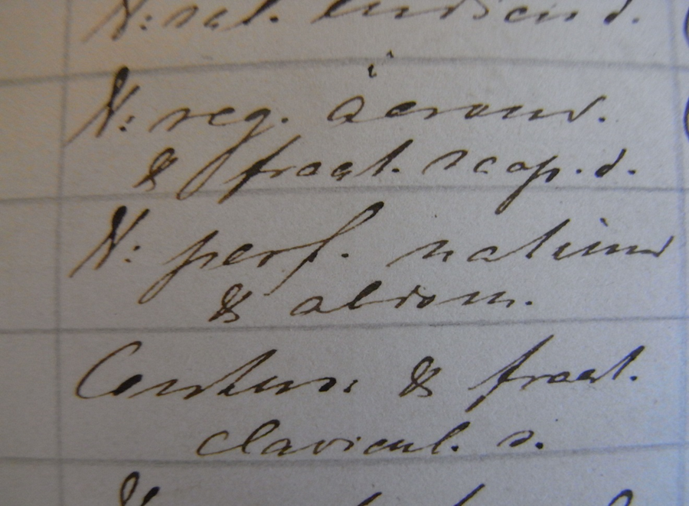
Lazaret, medical journal:
V: = vulnus (wound), perf. natum & alrom: perforated in the seat and other places

Slide 11
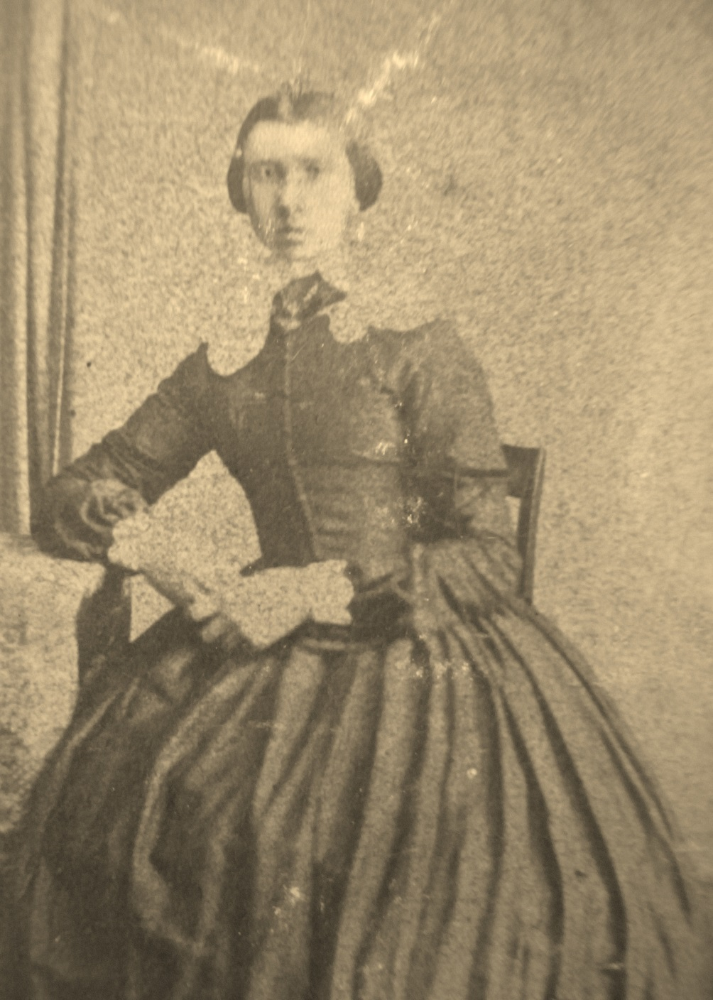
Jette Svendsen
1832-1916
Eriks greatgrandmother
Spinster, got a nine years younger man. Who seduced whom?
Child born four months after the wedding.
The child dies.
The man is send to war.
"Dark Mind“ (according to letters)

Slide 12
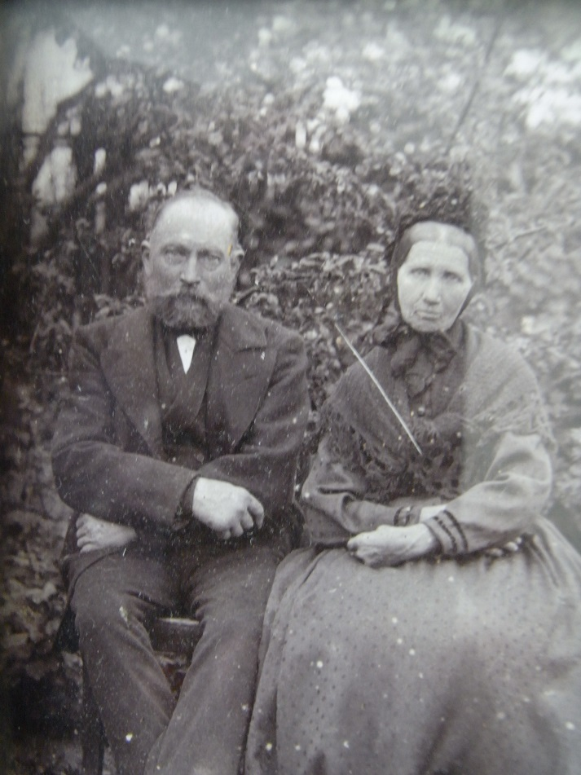
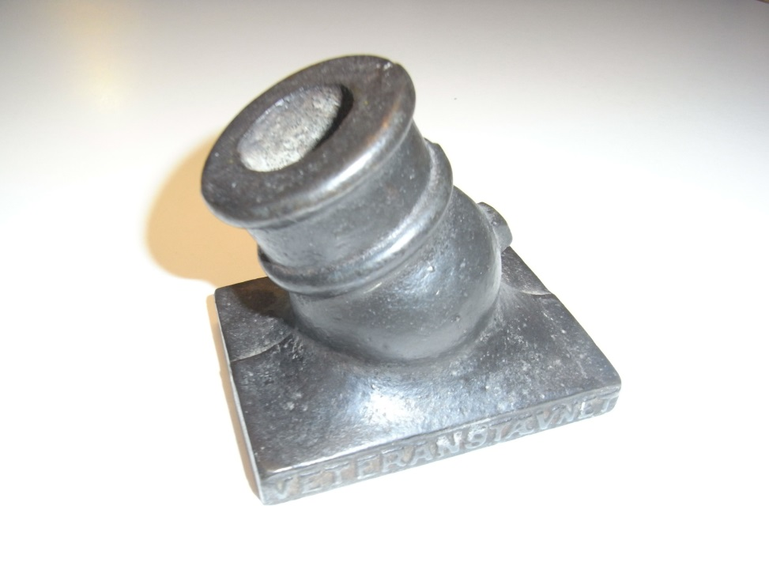
Svend and Jette in old age
Golden wedding anniversary1912
Svend 71 years, Jette 80 years
Veteran 1864 50 years-event, 1914,
Iron gun
“But the officers got the gun in silver!”
(Copper-plated iron?)

Slide 13
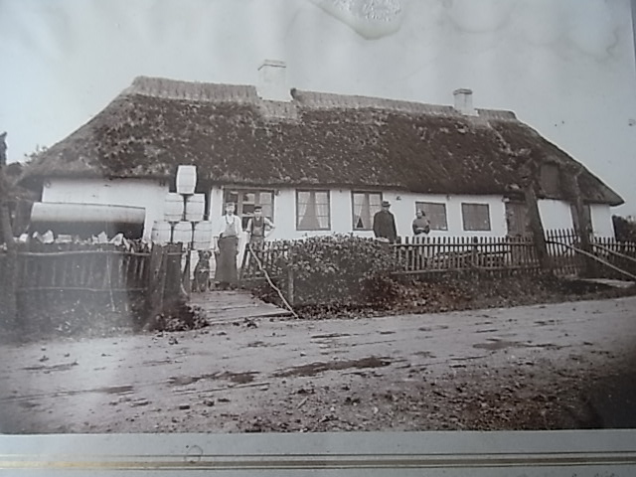
Johannes Svendsen,
1870-1934
Eriks Grandfather
Cooper (butterbarrels)
Factory Competition.
Flourdealer, haulier
“Veteran” no war
"Black pigs" during the first World War ("So you may well come at the high school")
Petty bourgeois
The skin on the nose
"Dark Mind” (wifes letter)

Slide 14
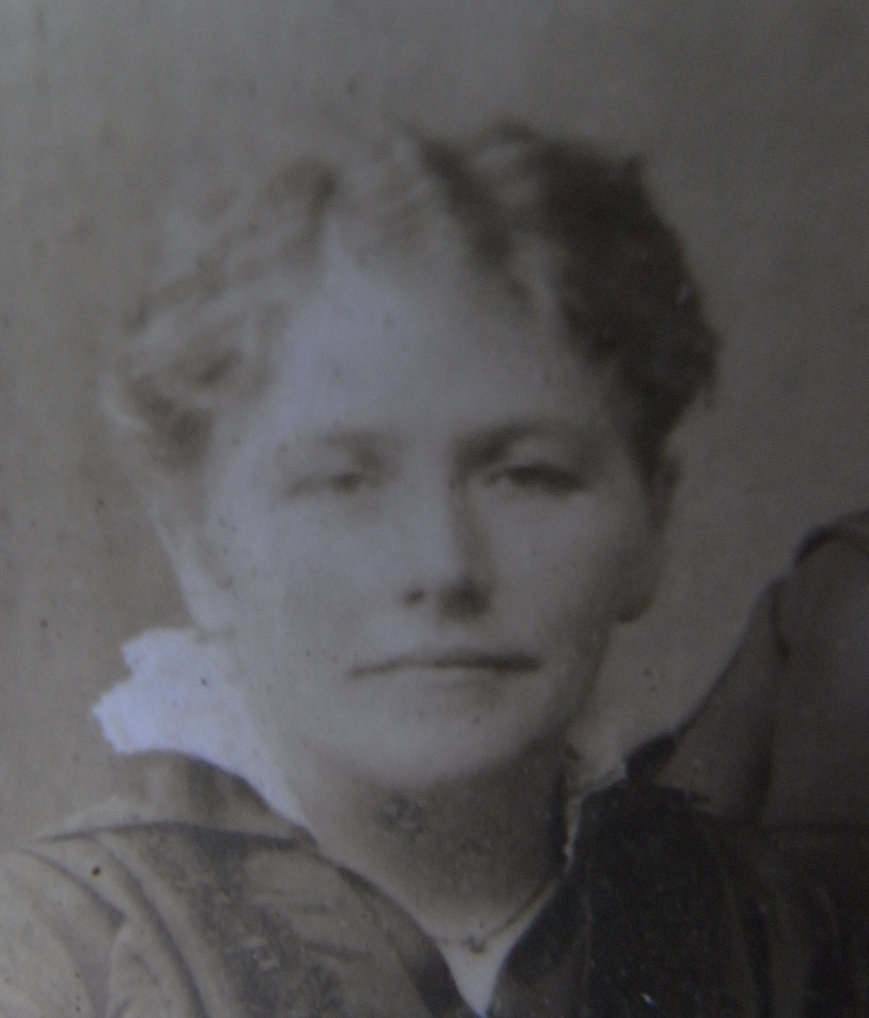
Nielsine Petermine Svendsen, 1875-1942
Eriks grandmother
Born of single mother
Orphaned at five (Swedish immigrant father) (Taboo?)
Poorhouse (Taboo?)
Talented (good marks)
Two infants died before Ejvind
Letters "dear sweet son"
"Bright mind" after her mother

Slide 15
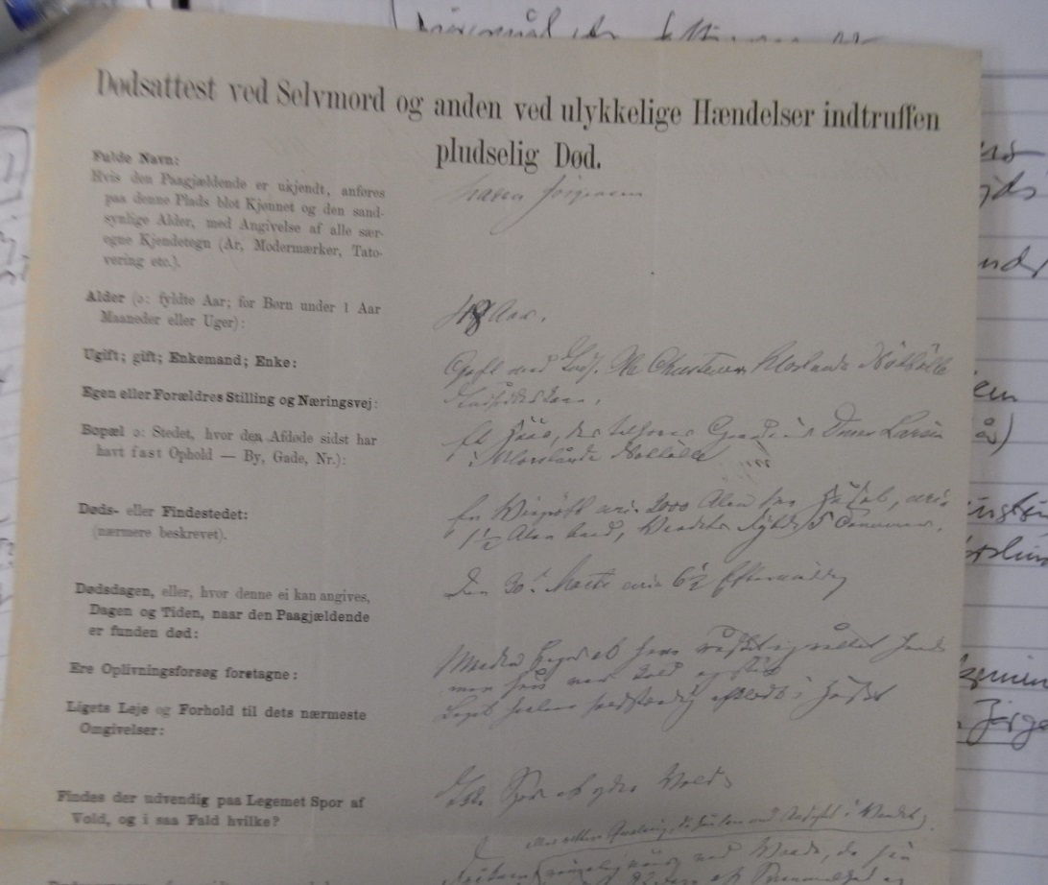
Maren Jørgensdaughter, 1832-1881
Nielsines mother
Unknown to Ejvind! (Taboo?)
Orphan 3½ years
Stepmother, in care.
Poorhouse (even mum)
Children with three men
Poorhouse but
come out to work, leaving Nielsine.
Gets (late) married
Death in a ditch (taboo?)
"Bright minds" !!!
No portrait

Slide 16
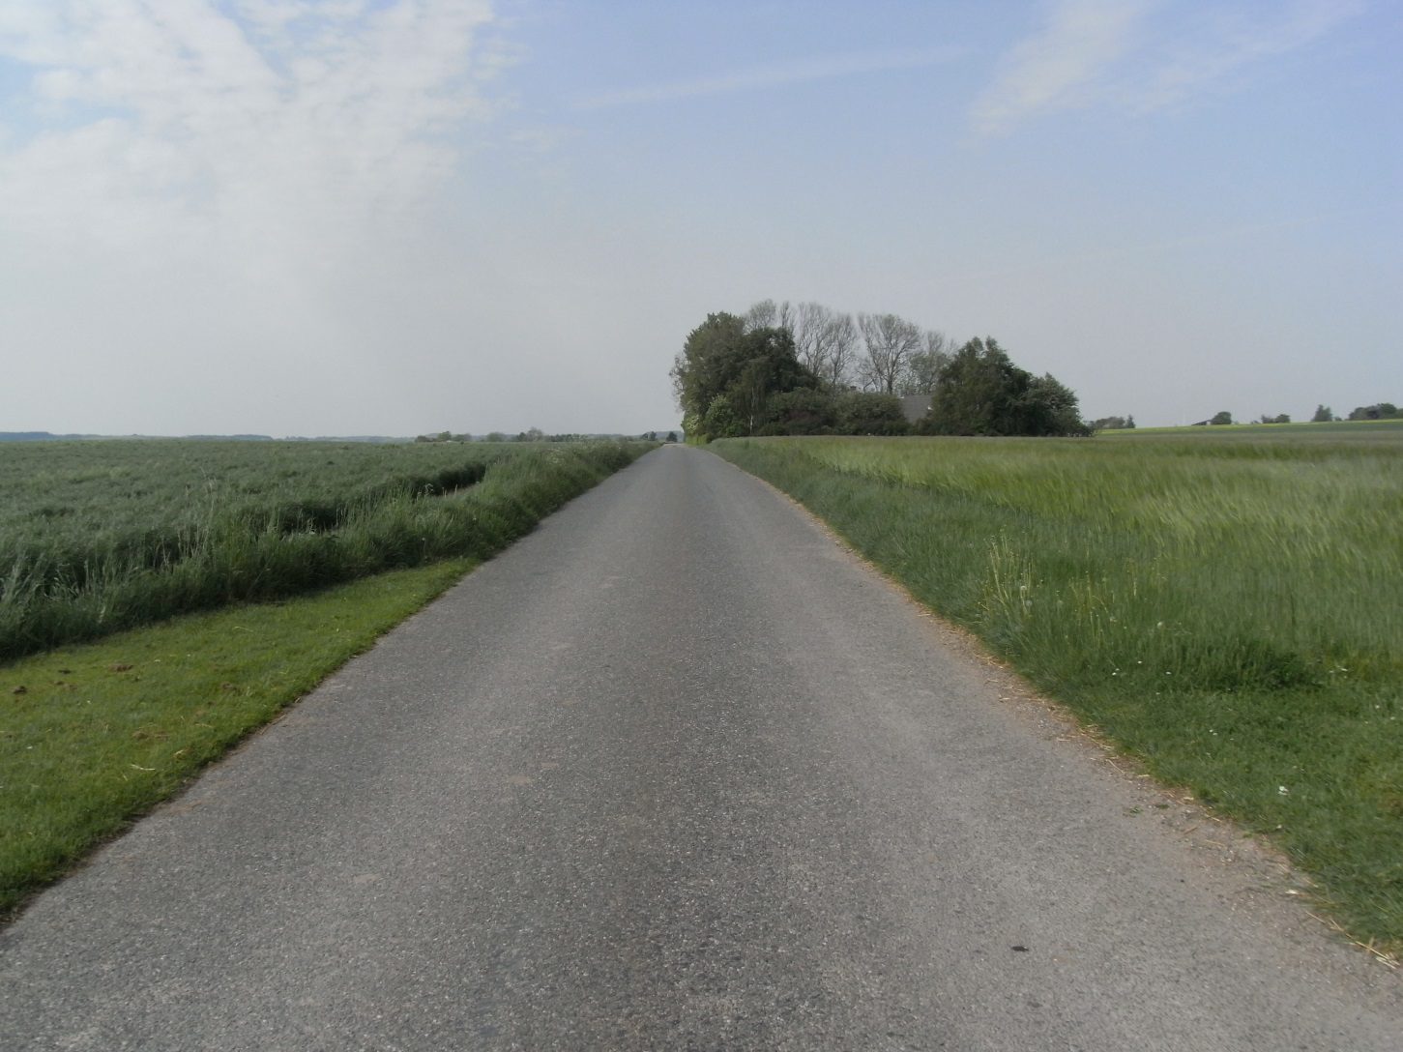
To Jutland, near Odder
Mind this road!

Slide 18
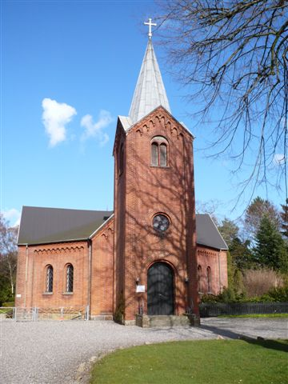
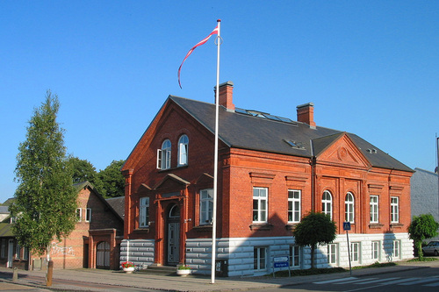
Claus Christensen, Quartermaster in Odder
Technical School
Church of free congregation

Slide 19
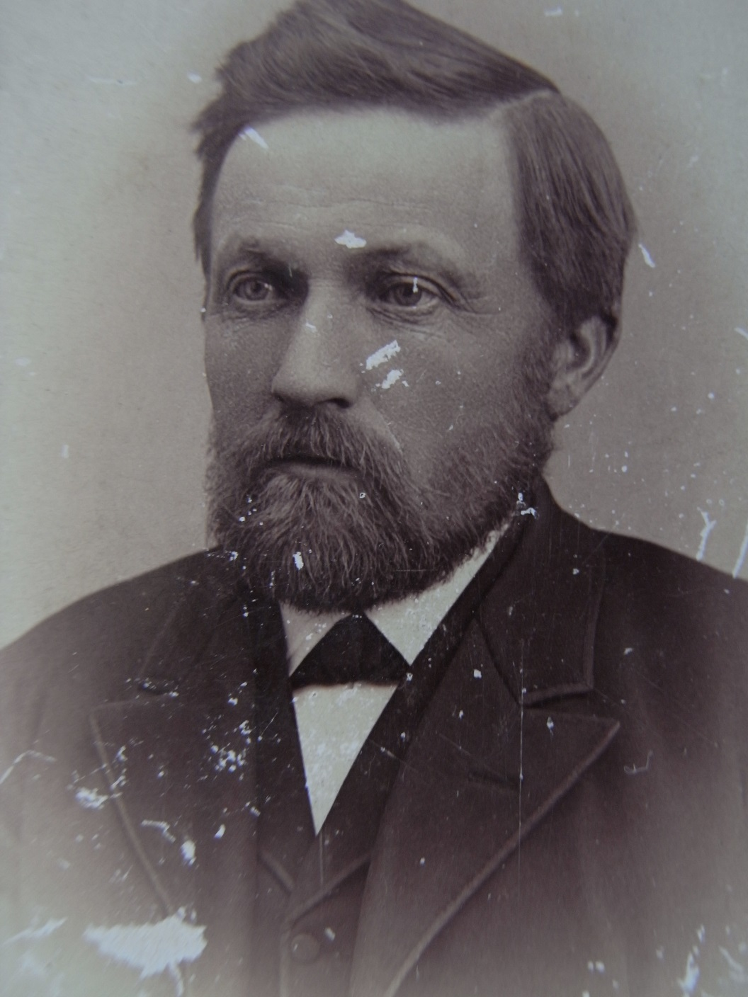
Claus Christensen,
1844 – 1915
Eriks Greatgrandfather
The son of a single mother, a widow in poor relief, and a married man (Taboo?)
Married to Cooper's daughter
Convicted of attempted rape 1 year prison (Taboo?)
Rehabilitation by king Christian IX
Father of five adult children
A respected citizen of Odder

Slide 20
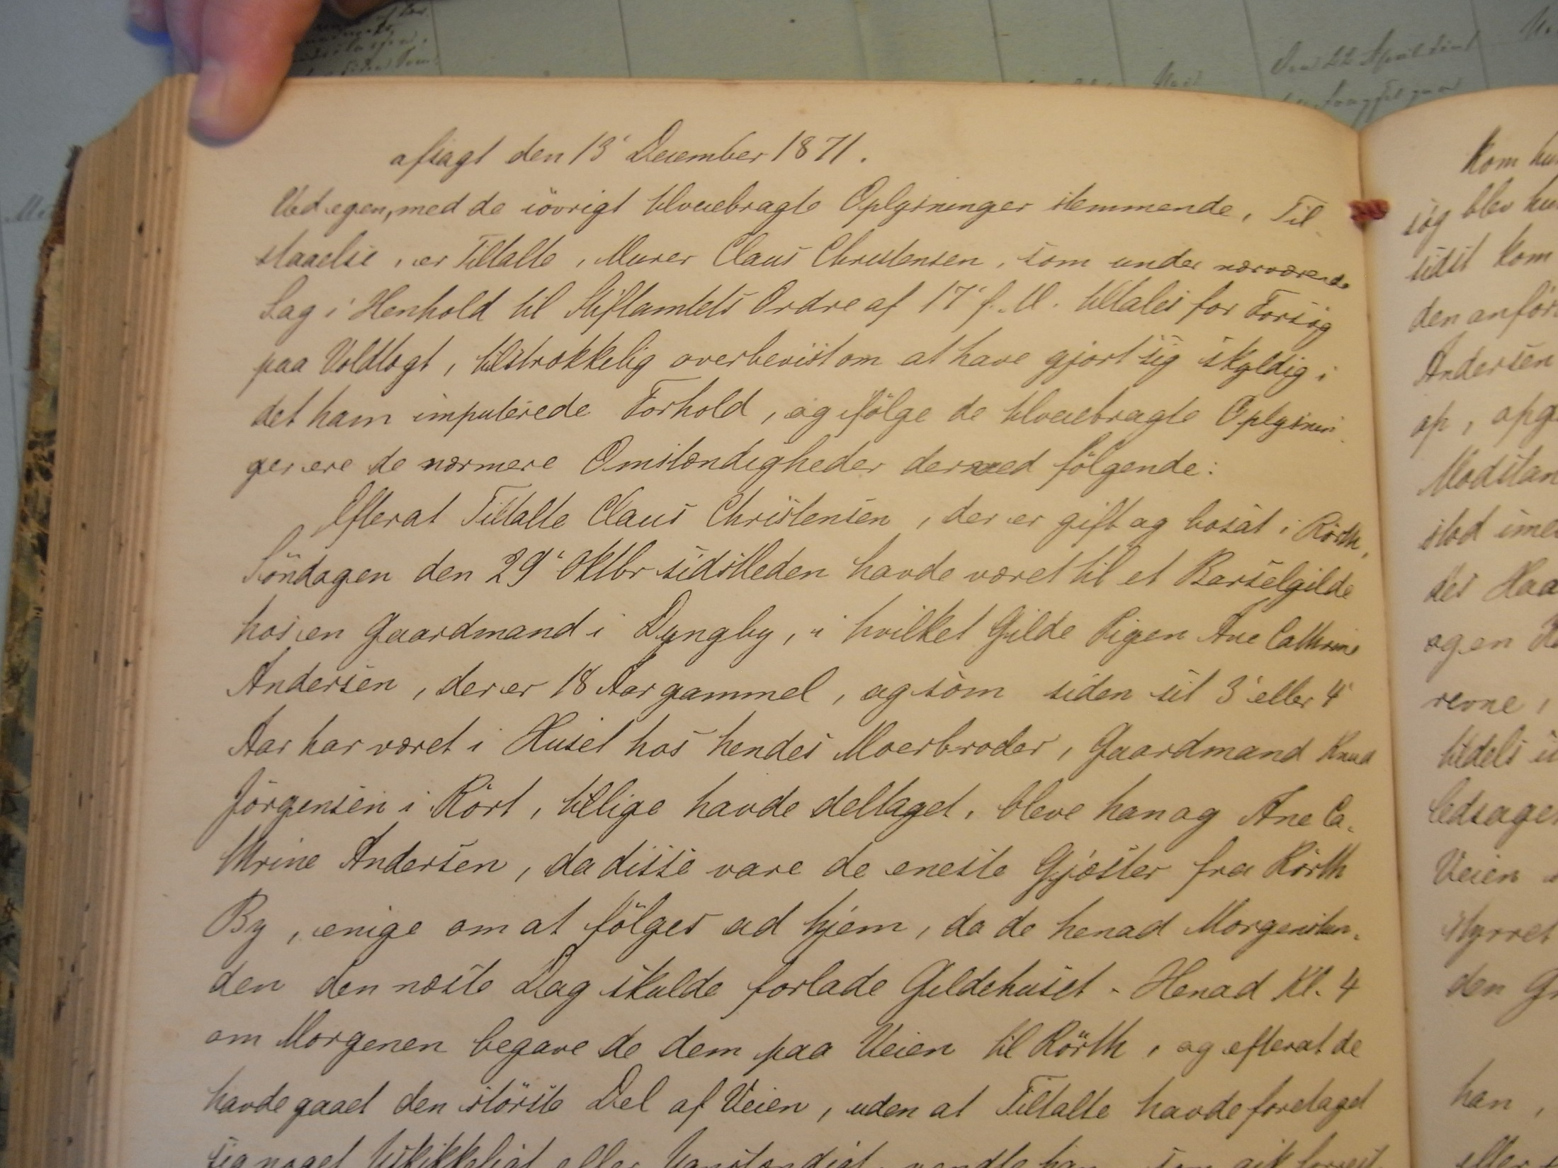

Slide 21
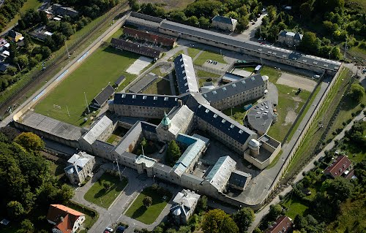
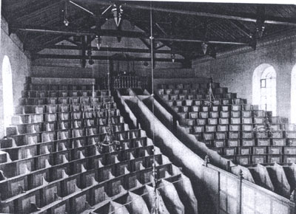
Vridsløselille prisson (”Philadelphia”)

Slide 22
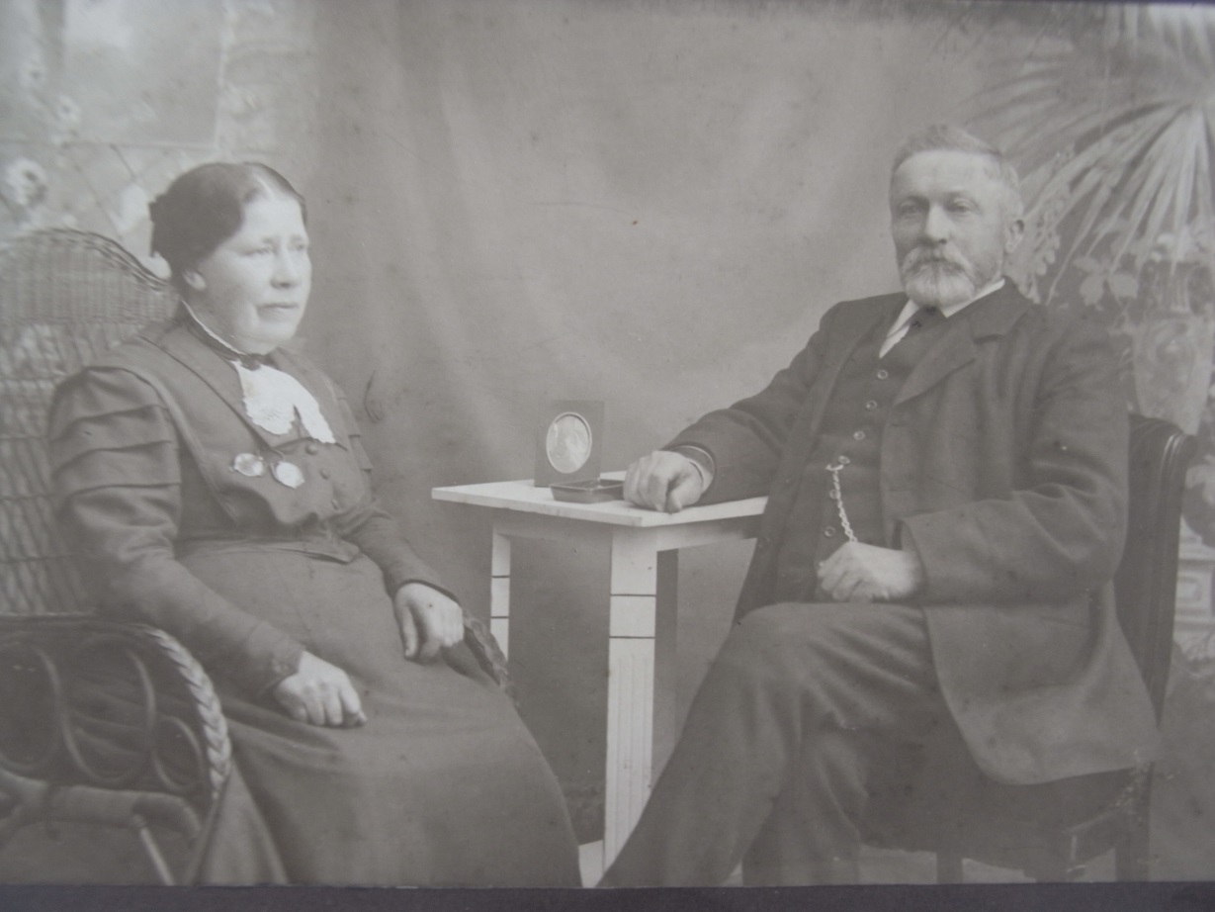
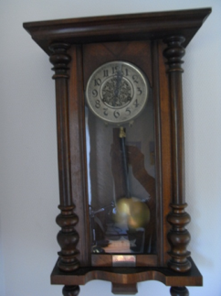
Ane Christensen
1848 – 1926
Eriks Greatgrandmother
Married1871
Husband 1 year in prison 1872 for attempted rape, Regret (Taboo?)
Ane waited for him. Forgiveness?
Gave birth to six children
Silver-wedding
Present:

Slide 23
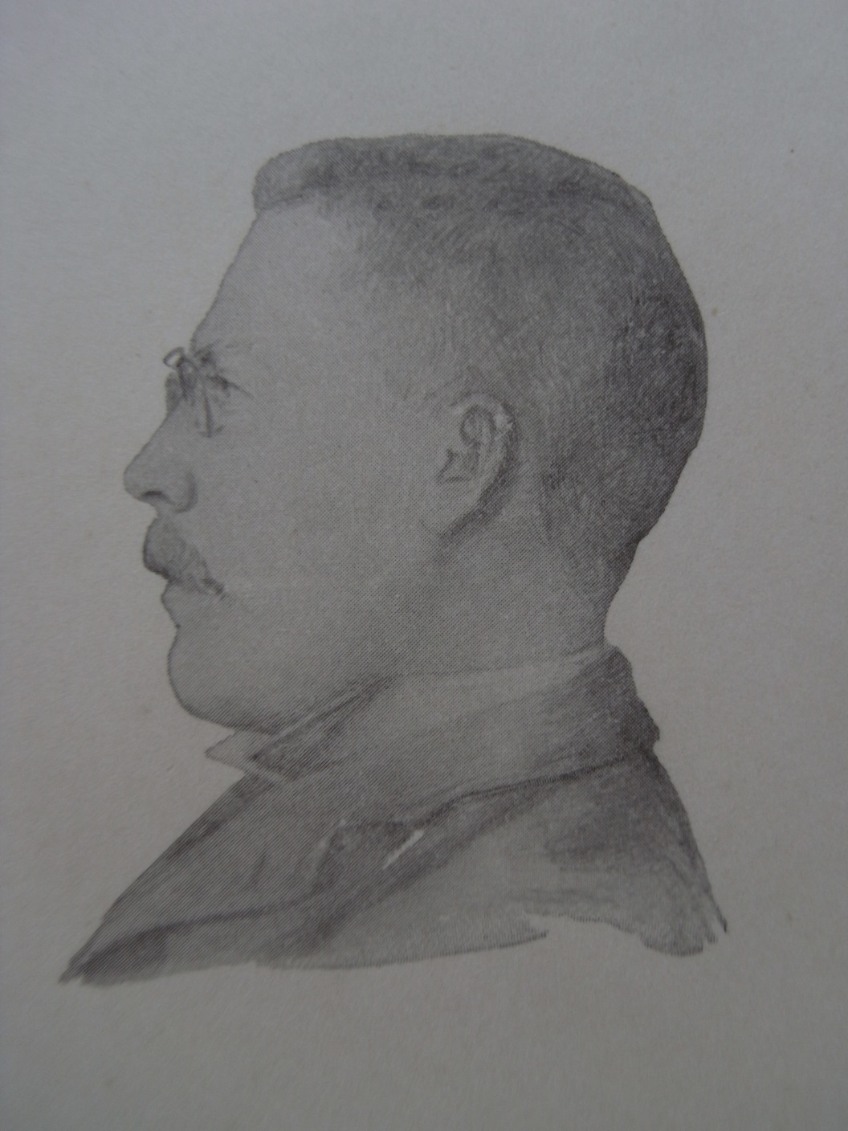
Peder Christensen
(Eriks Mothers father)
1876-1956
At the seminary already when 16 years old.
Teacher in Middelfart
Danish, Swedish, Geography.
Travel to Montenegro 1904
Radical Left (1905)
Had a car in the 1920s.
Lived with us in Sorø his last eight years.
Had a magic gold watch

Slide 24
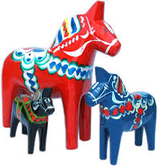
Now to Sweden, Dalarna

Slide 26
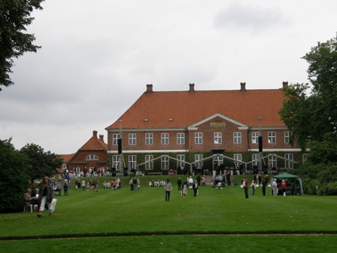
Hindsgavl Mannor near Middelfart
Nordic handicraft course,
The Baroness invited the local Swedish teacher to entertain the young ladies....
Peter & Sally found each other
Coincidence? Love.

Slide 27
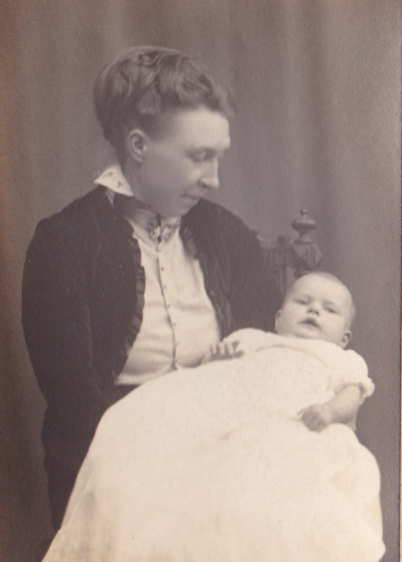
Sally Christensen
Sally Christensen, born Fellenius
1882-1947
(Eriks Mothers mother)
Grown in Falun in Dalarne
Ice-skating in Stockholm with her fiancé 1907
My mother youngest of three
Housewife
Kept her Swedish language all life.
Engaged in society

Slide 28
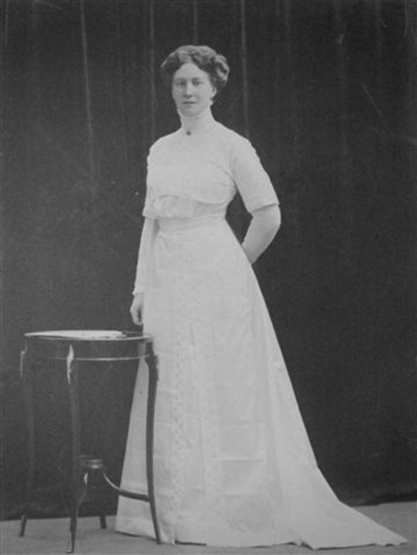
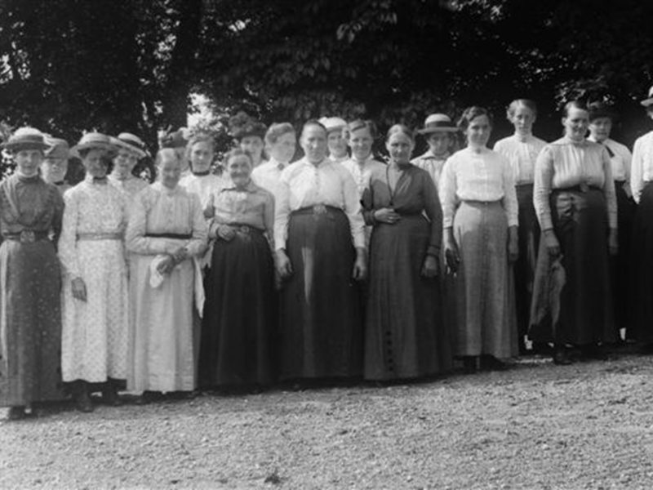
Sallys sister Signe was married Isoz at Åda Manor
From housekeeper to Madame
21 women from the estate to Madam’s birthday-coffee

Slide 29
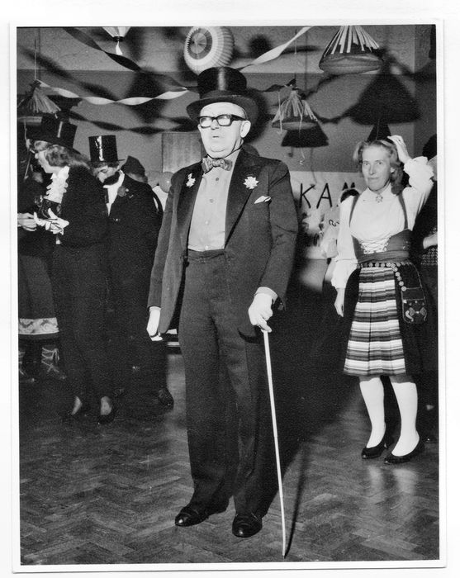
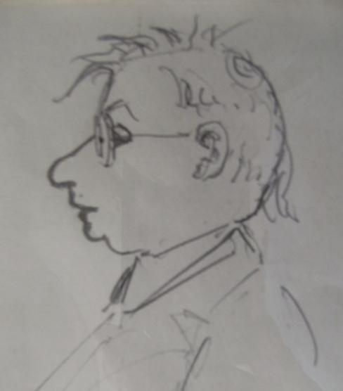
Ejvind og Ingeborg (Eriks parents) at a carnival
Ingeborg (1916-2000) in the folk-dress from Dalarne. She made Erik a quarter of a swede.
Ejvind (1903-1984) was born almost blind, operated when 5 yrs, blind again in 1964.

Slide 30
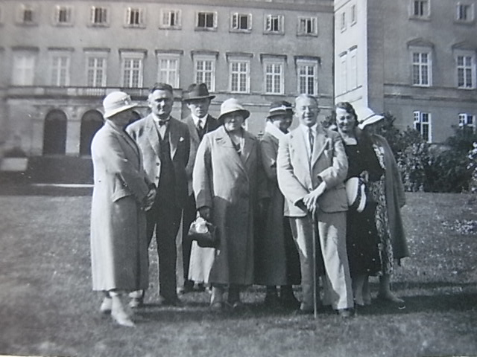
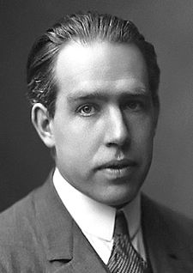
Visit from Lolland to Sorø Akademi ca 1935
The smiling, happy lecturer Ejvind with his mother, Nielsine Petermine and friends
Is Nielsine proud !?
Is Ejvind?
Was Niels Bohr proud?
From poorhouse to ...
Light and dark minds

Slide 31
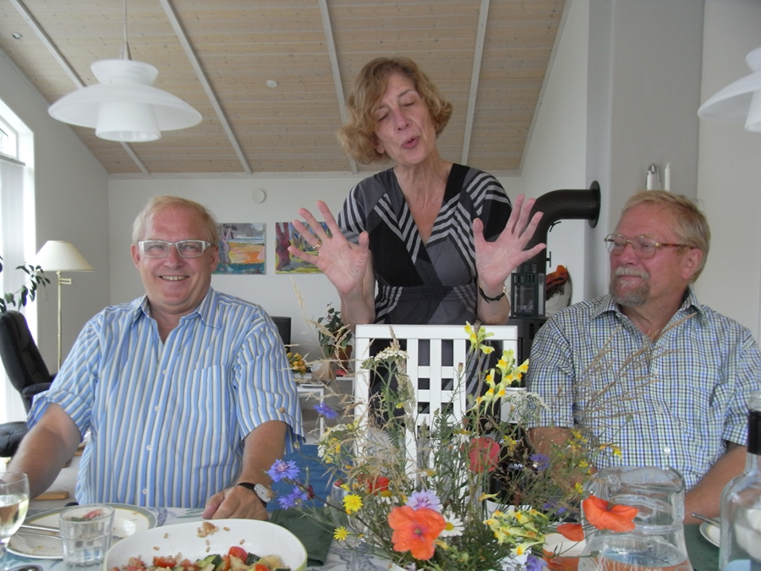
Per (1941), Ulla (1943) og Erik (1945)

Slide 32
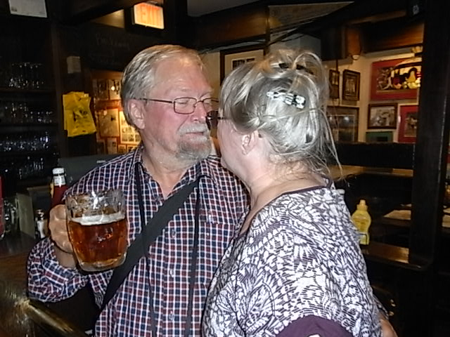
“Cheers”, Boston, 12. okt. 2015

Slide 33
Now where?
Thank you!

